Slide 1
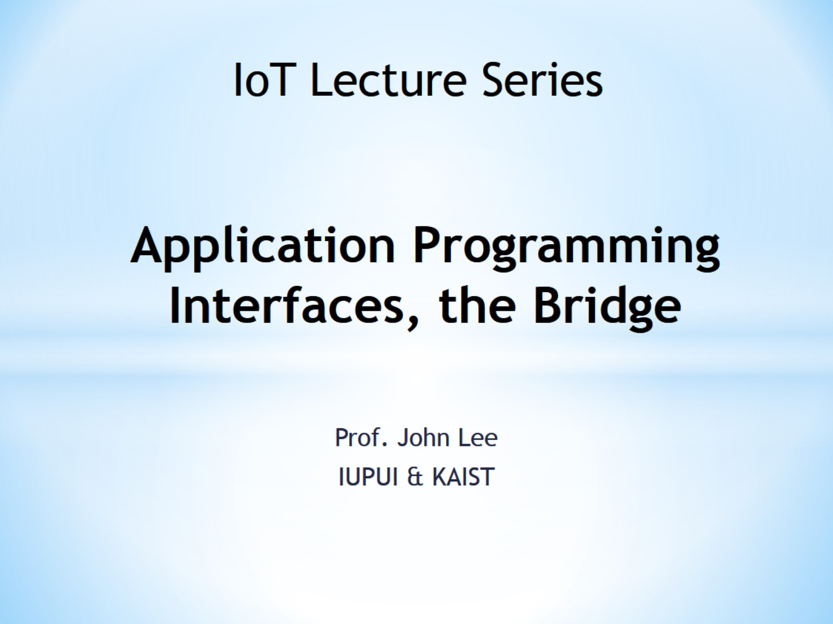
Application Programming Interfaces, the Bridge

Slide 2
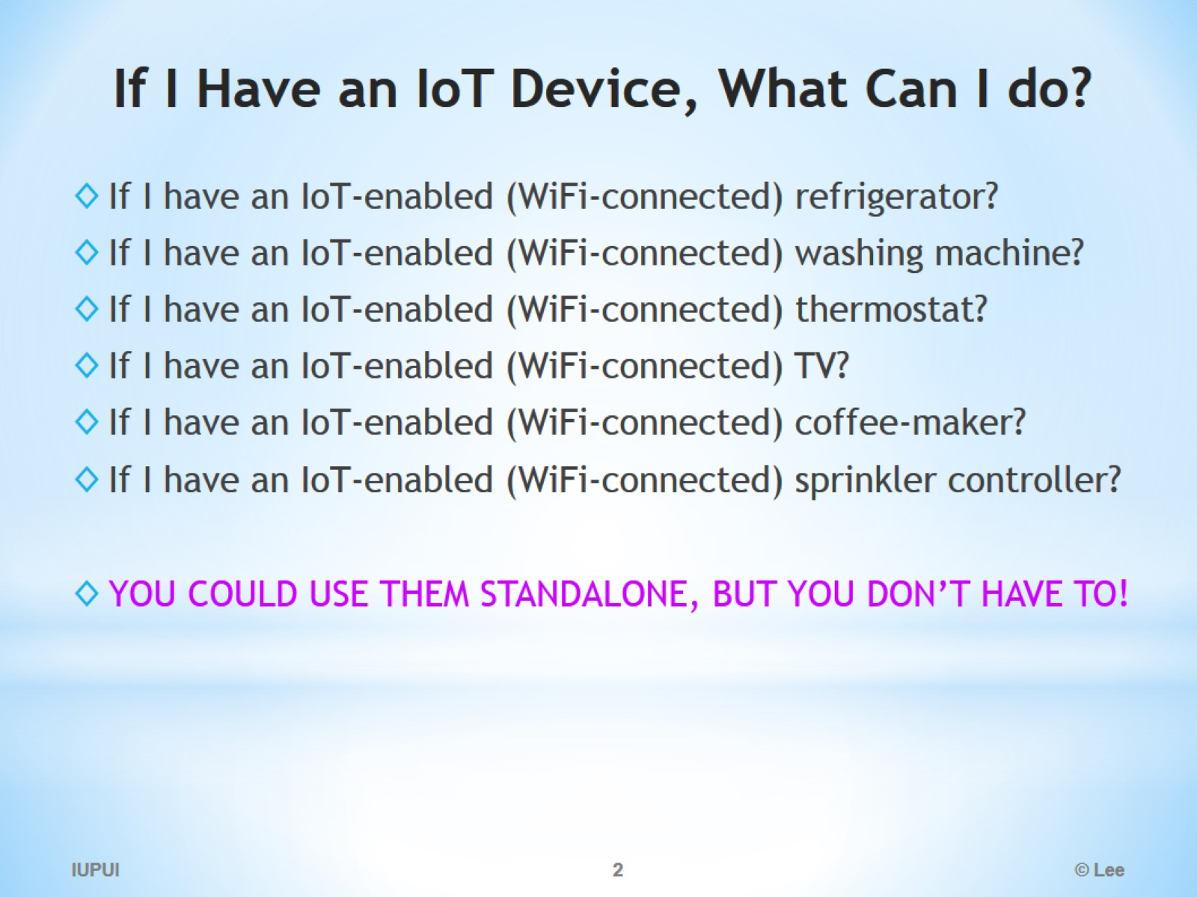
If I Have an IoT Device, What Can I do?

Slide 3
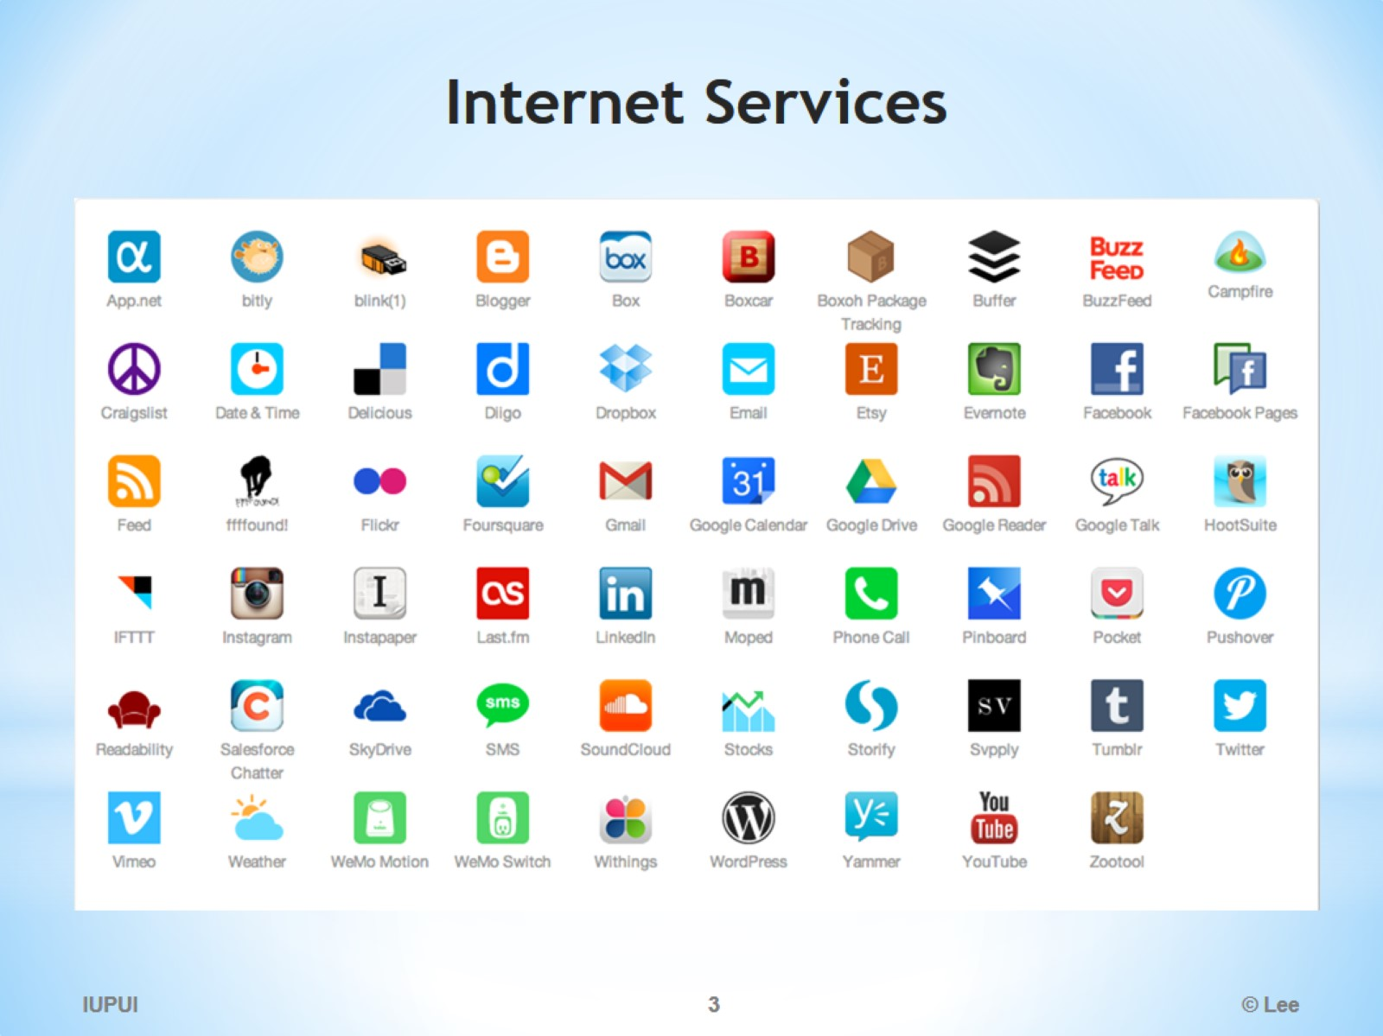
Internet Services

Slide 4
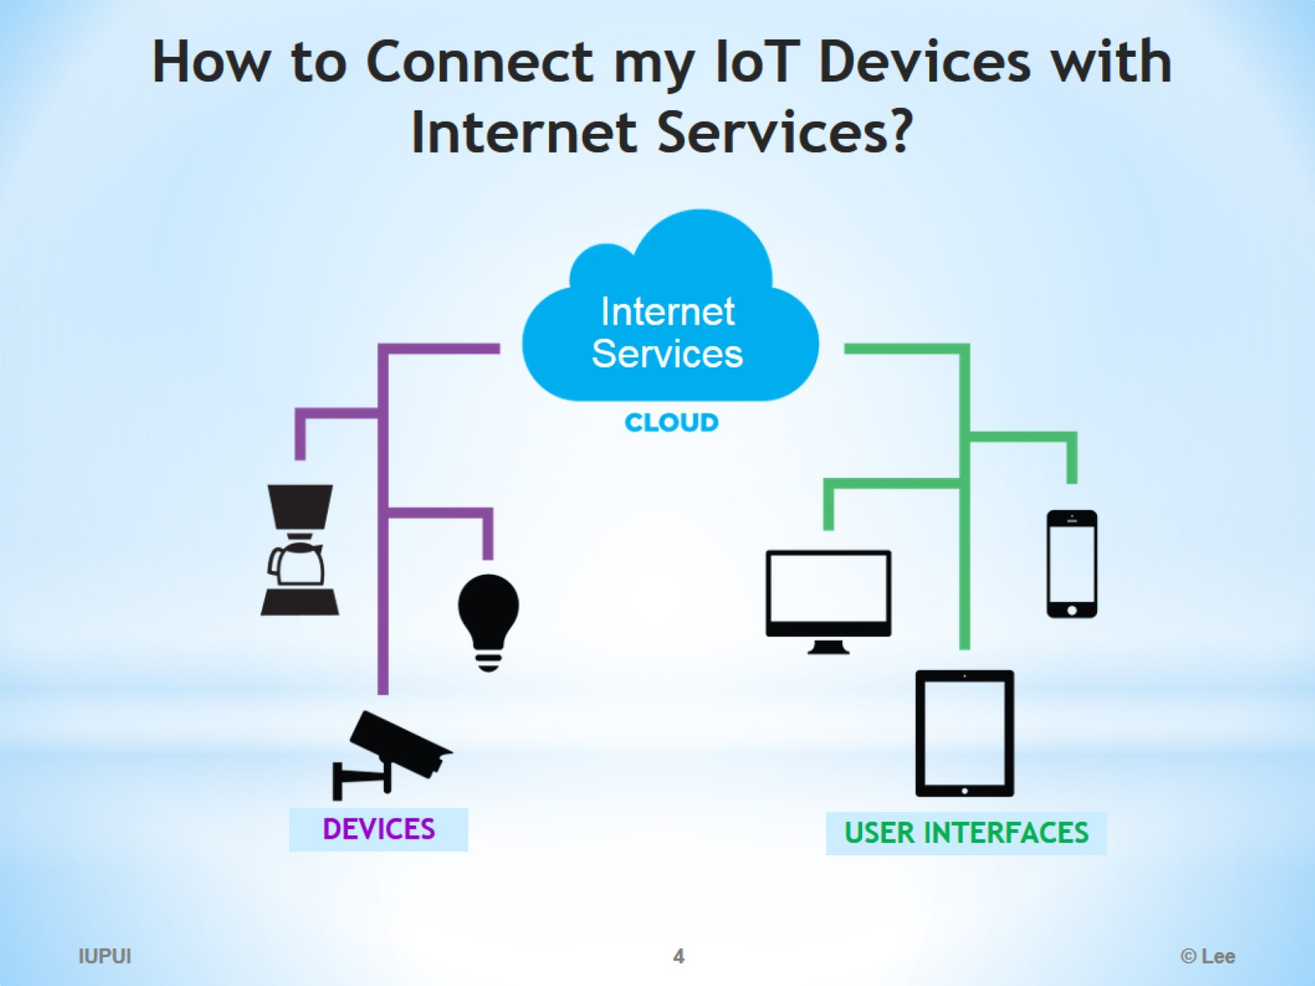
How to Connect my IoT Devices with Internet Services?

Slide 5
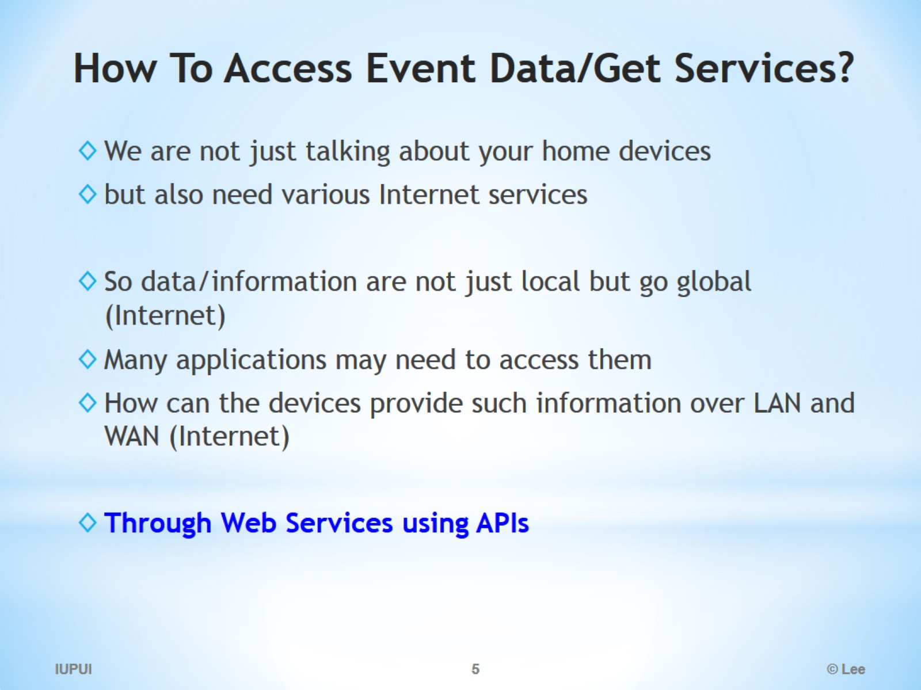
How To Access Event Data/Get Services?

Slide 6
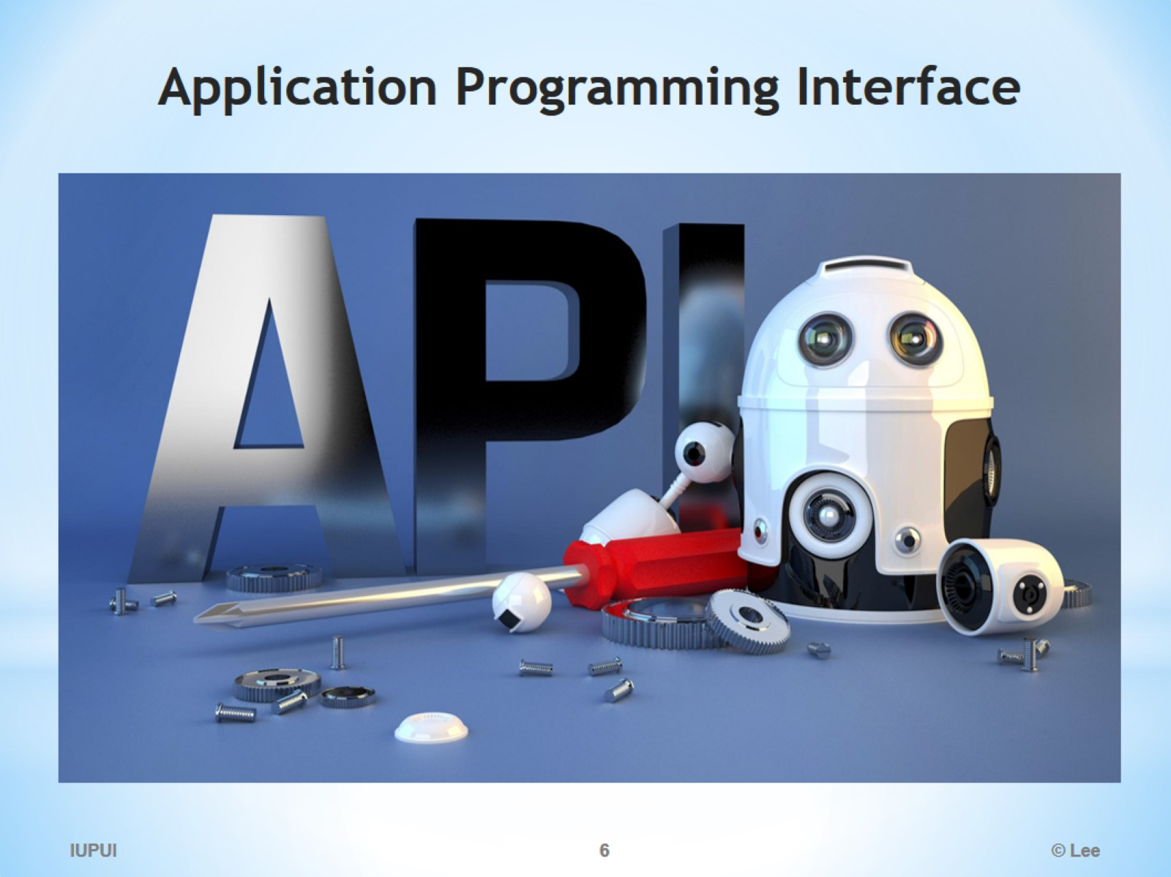
Application Programming Interface

Slide 7
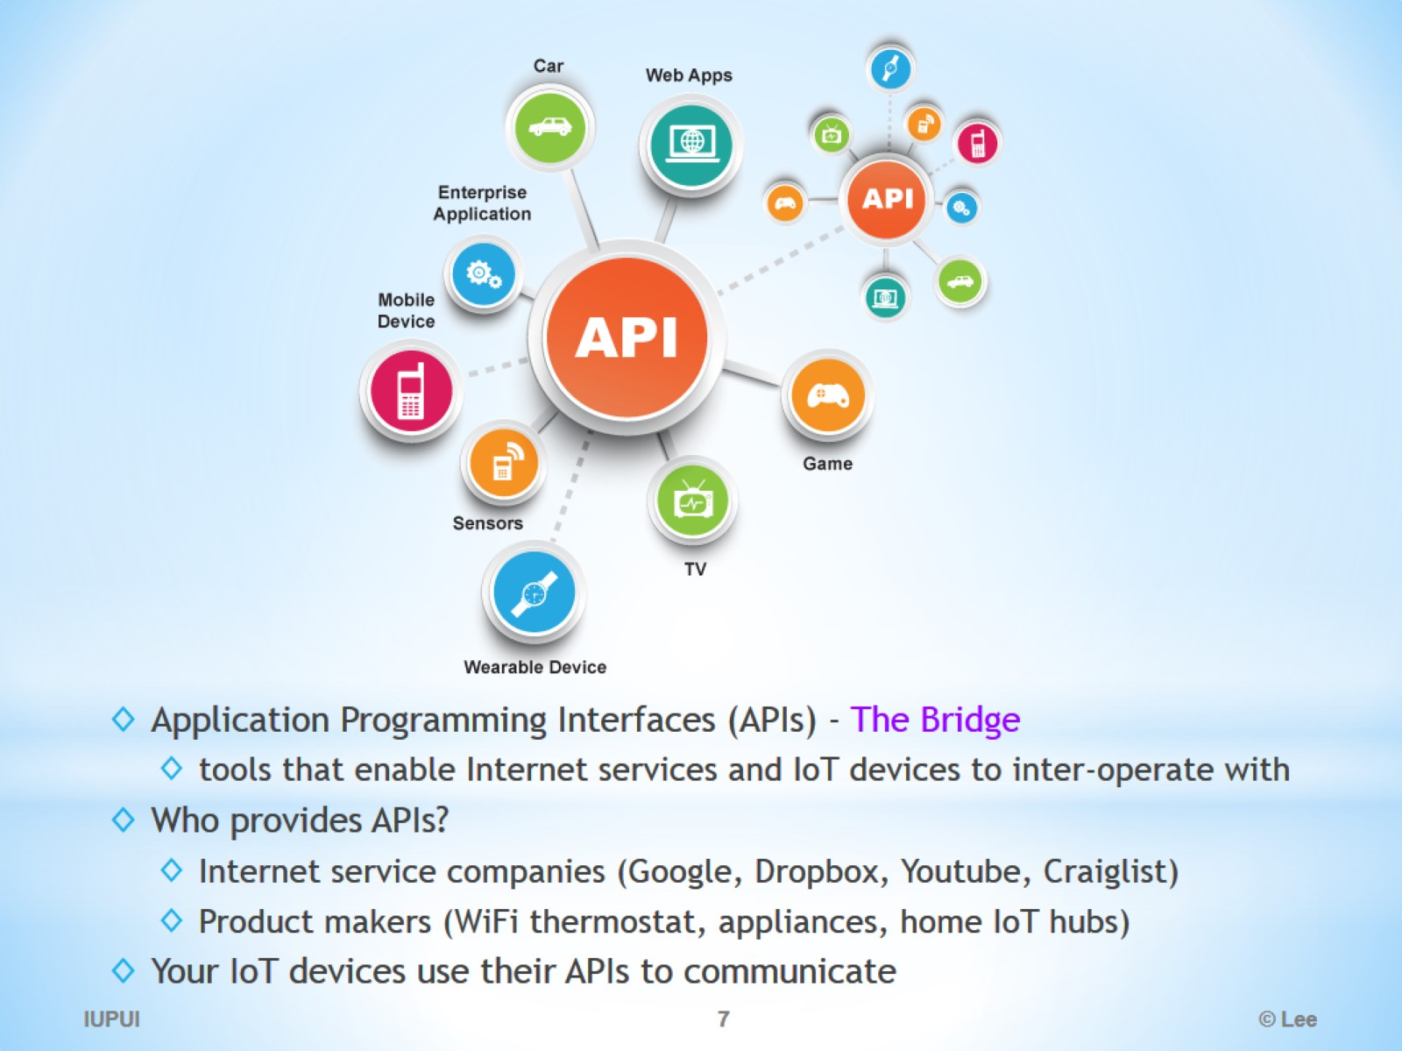

Slide 8
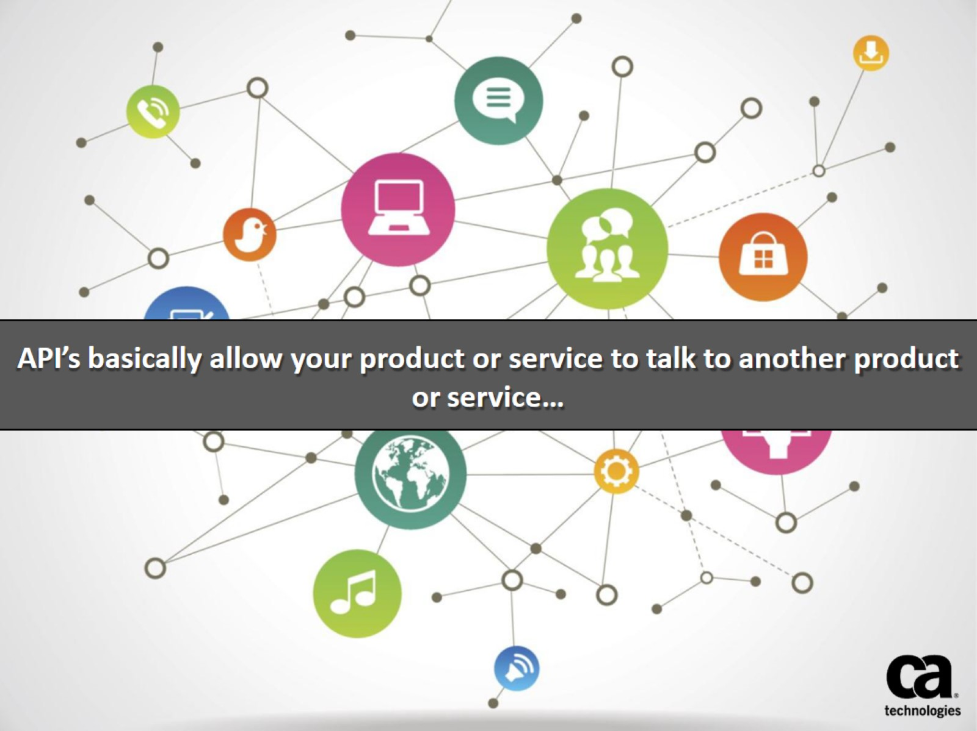

Slide 9
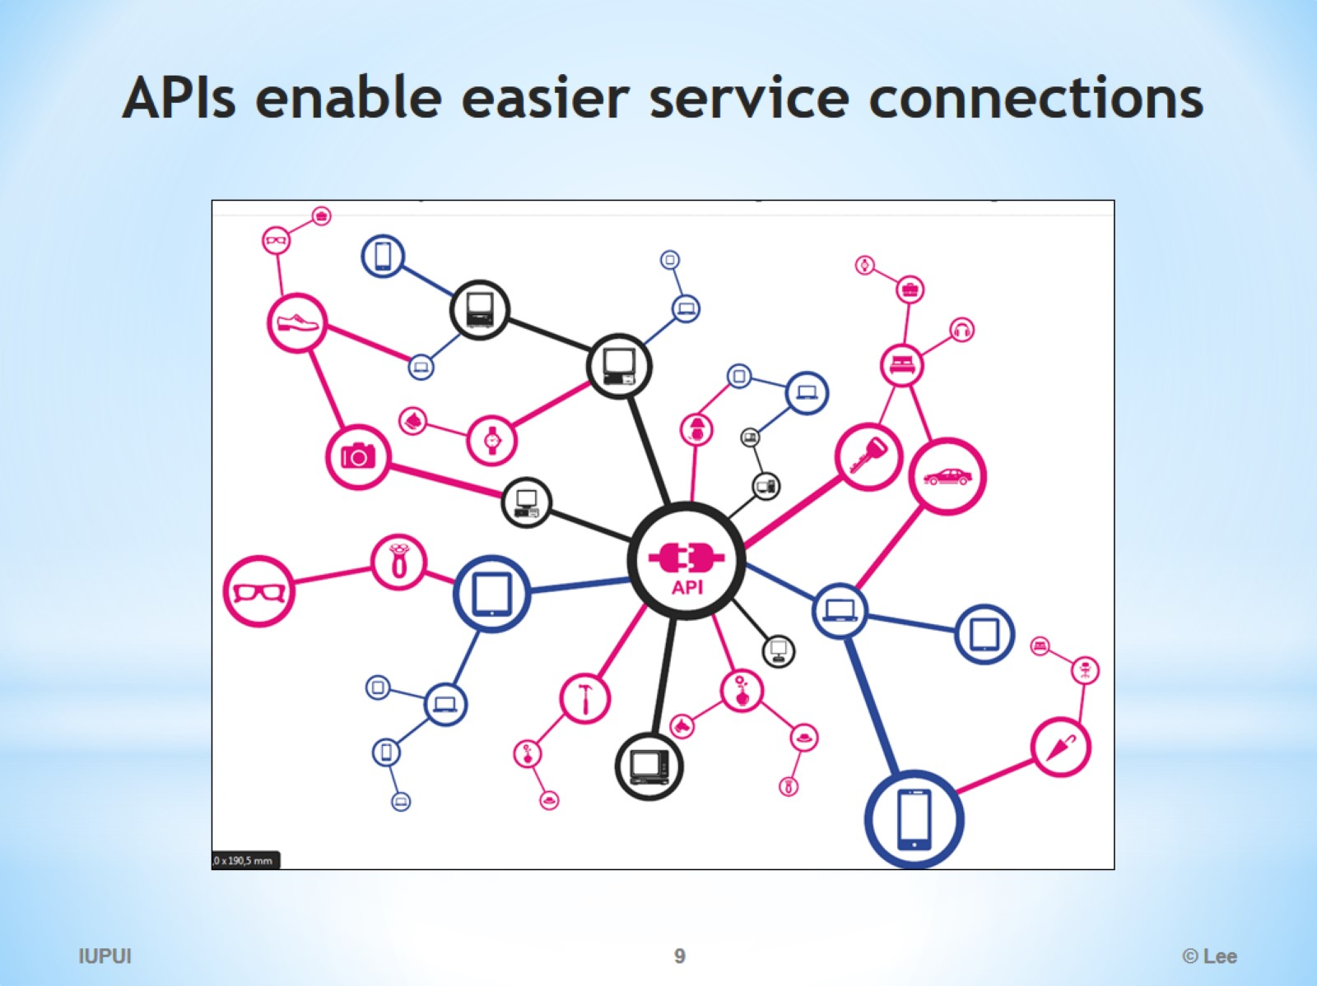
APIs enable easier service connections

Slide 10
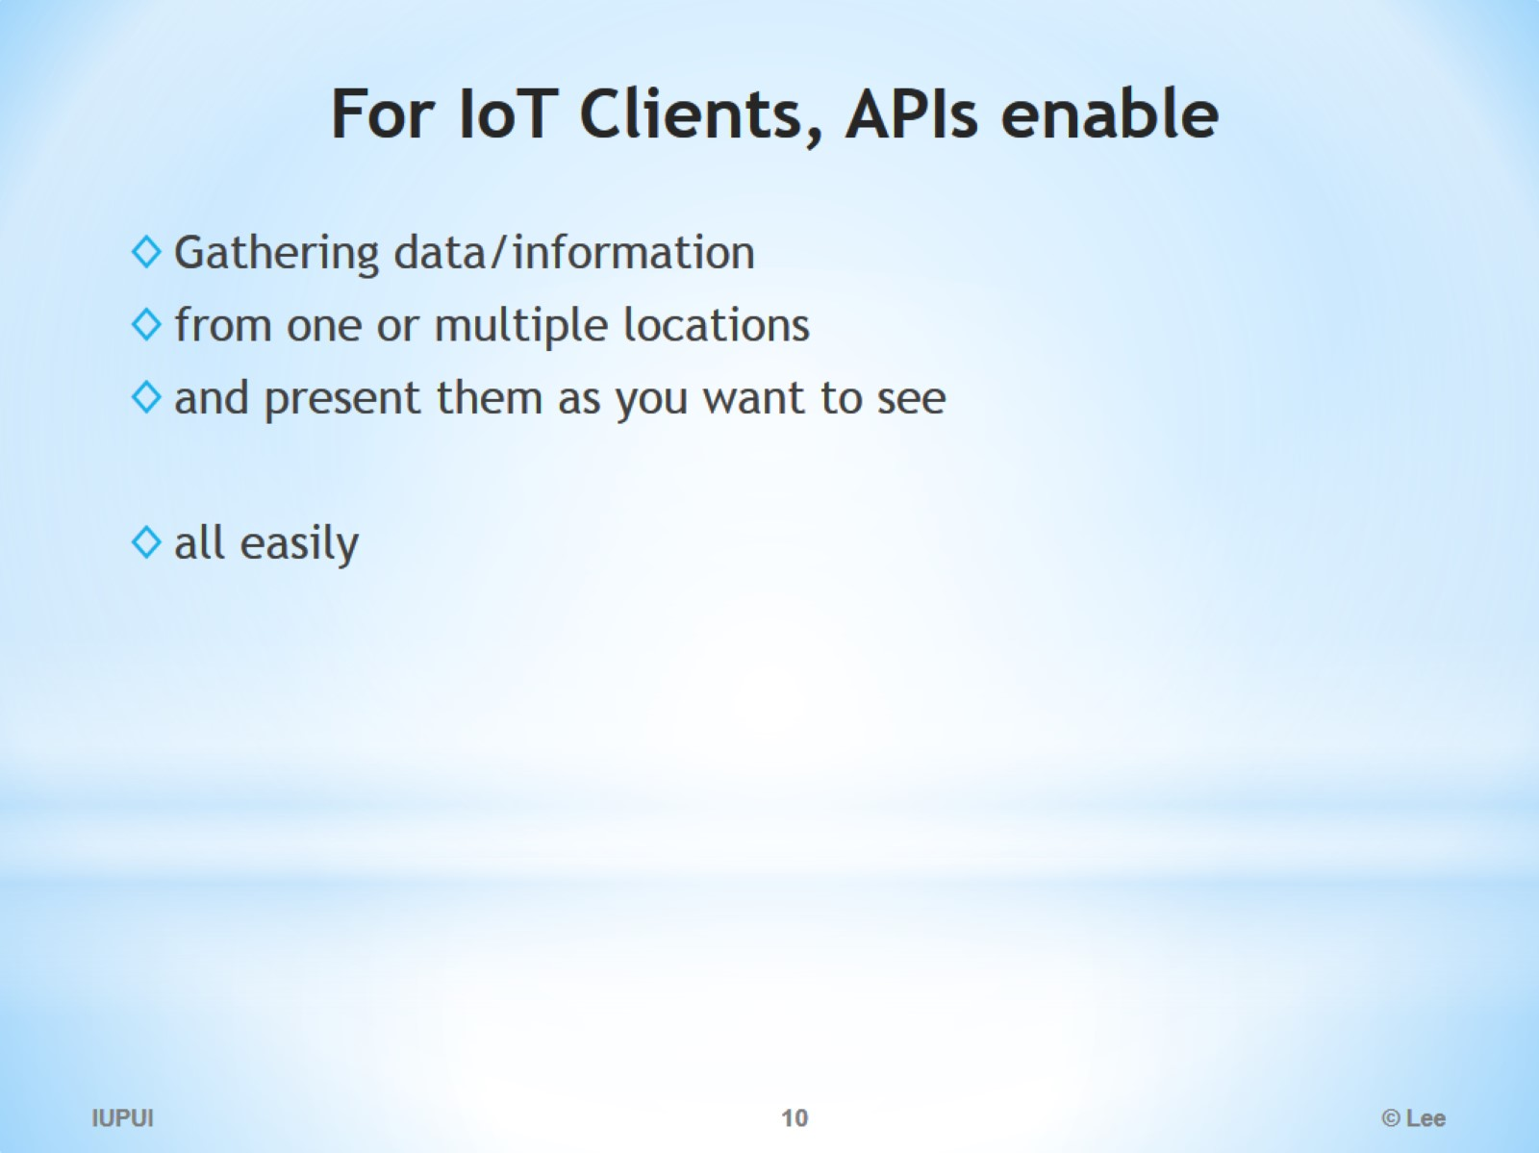
For IoT Clients, APIs enable

Slide 11
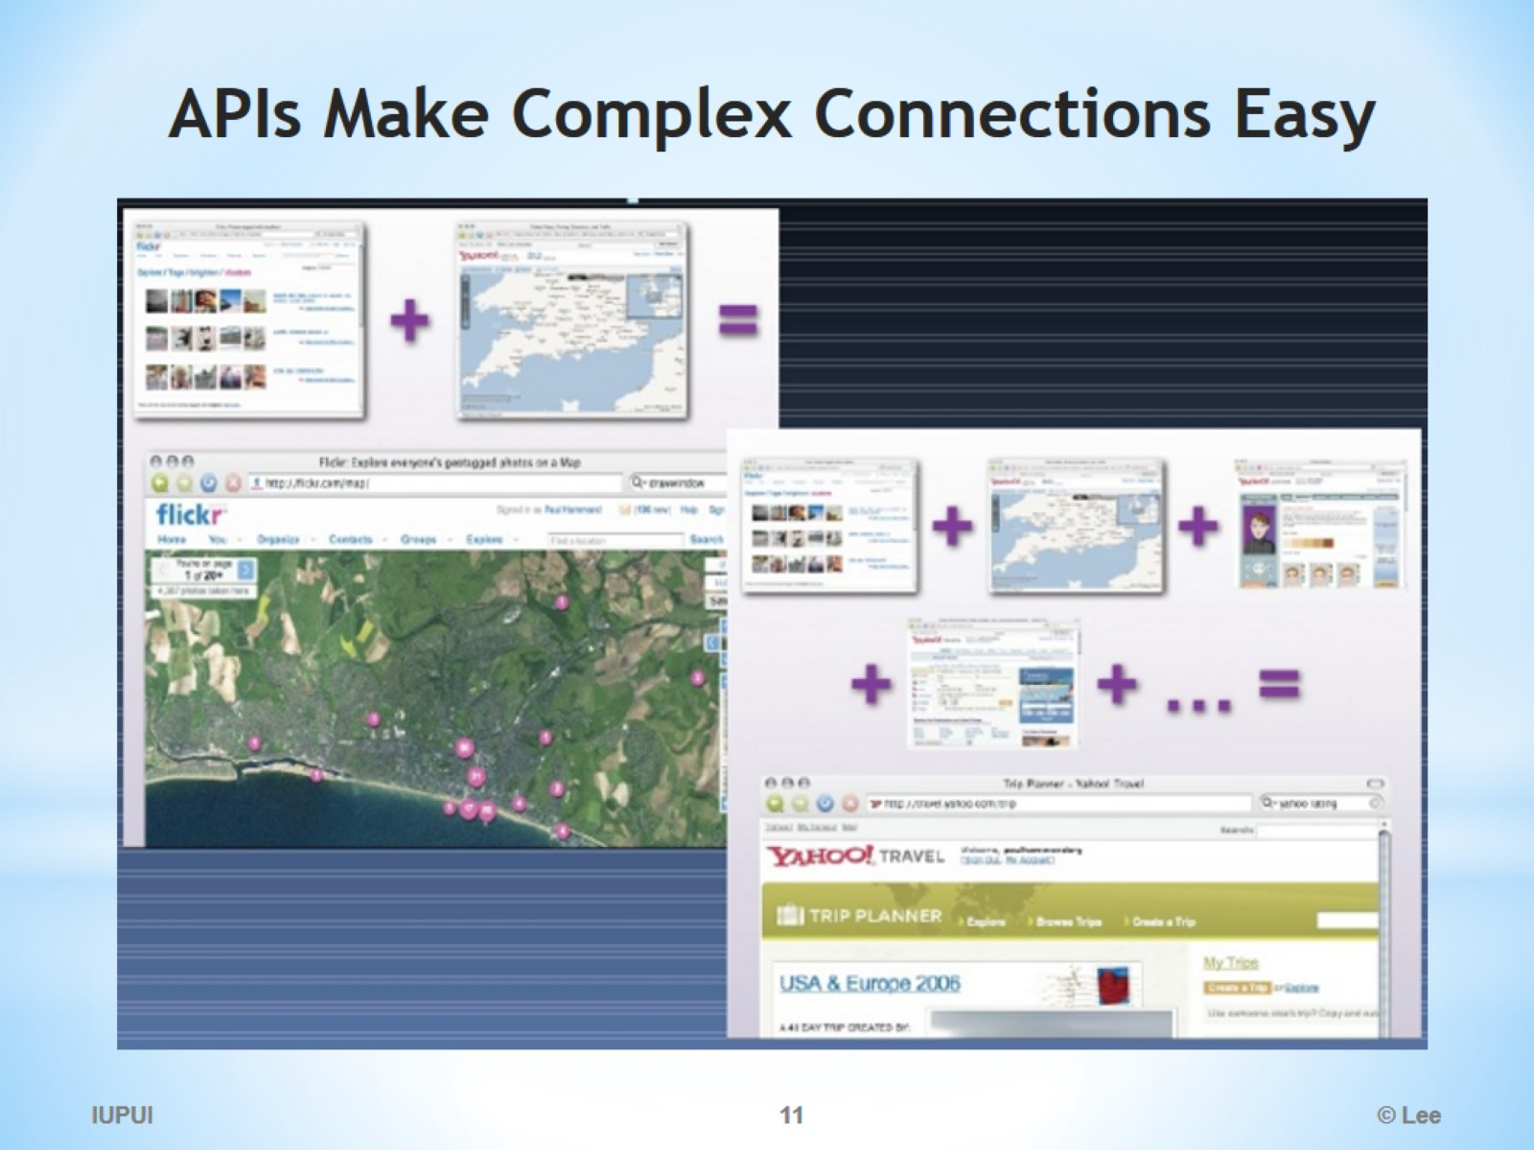
APIs Make Complex Connections Easy

Slide 12
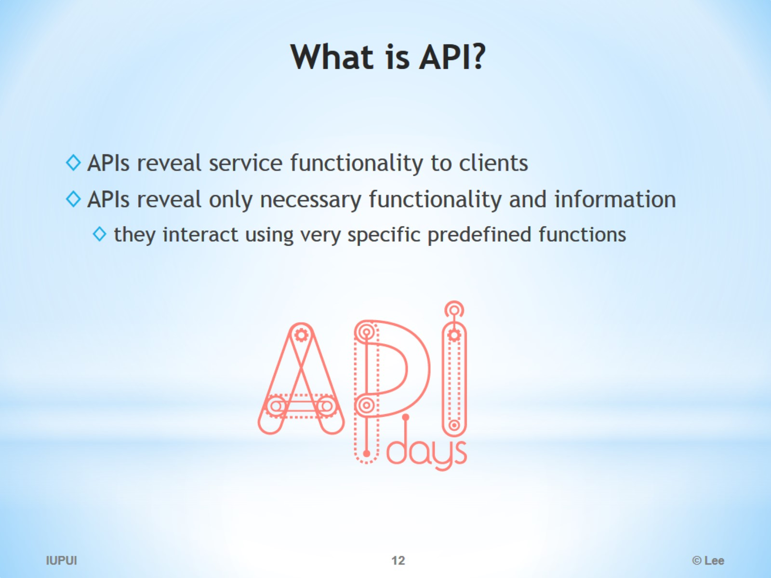
What is API?

Slide 13
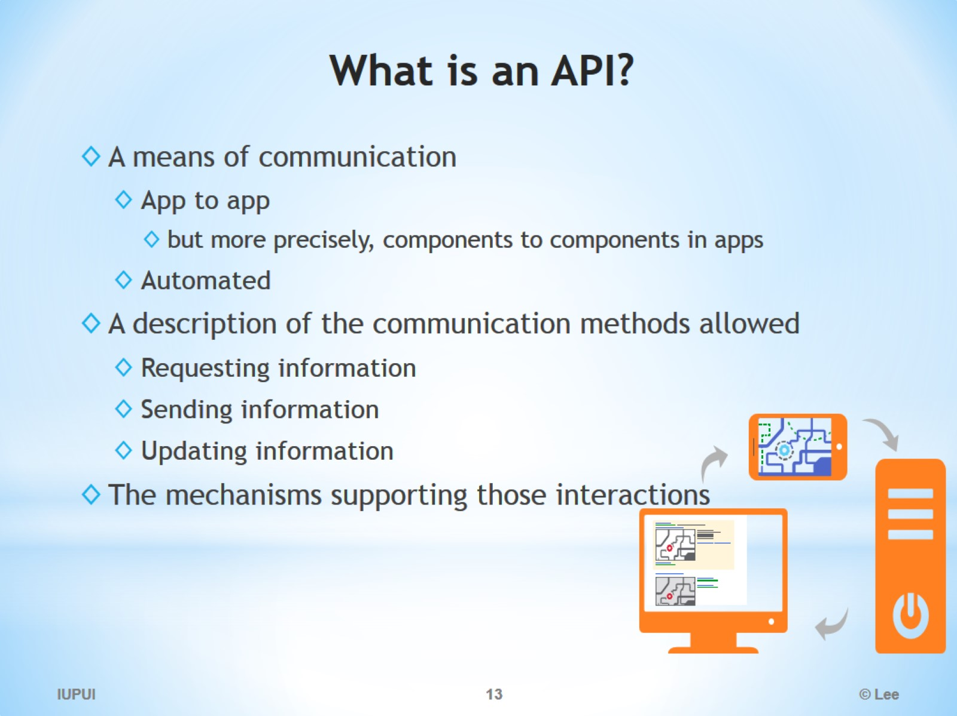
What is an API?

Slide 14
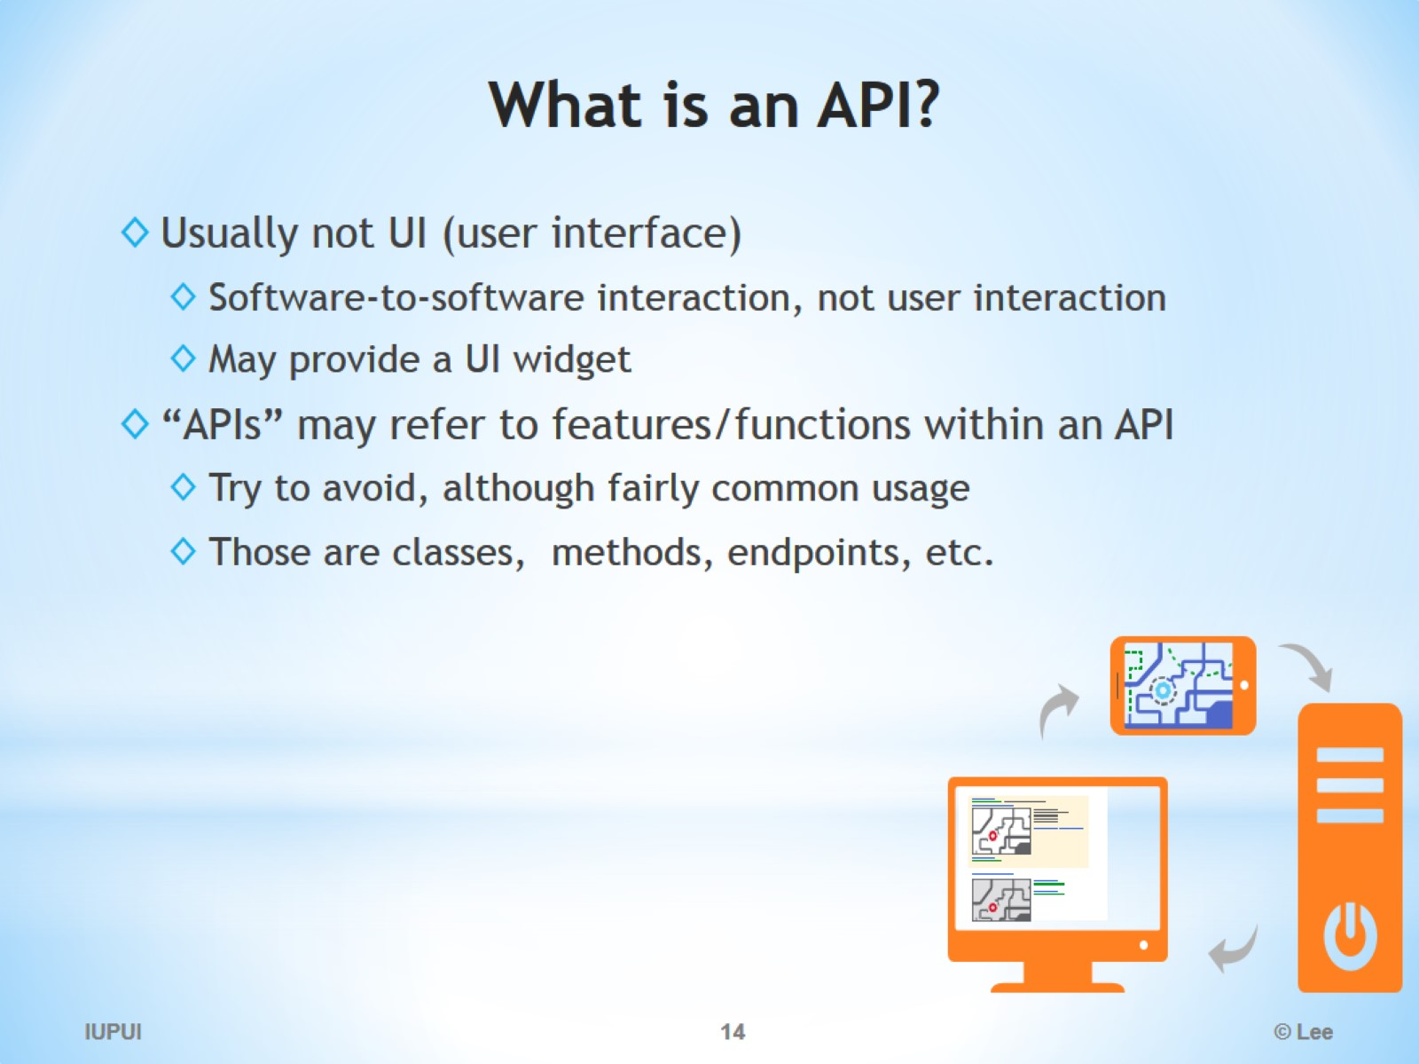
What is an API?

Slide 15
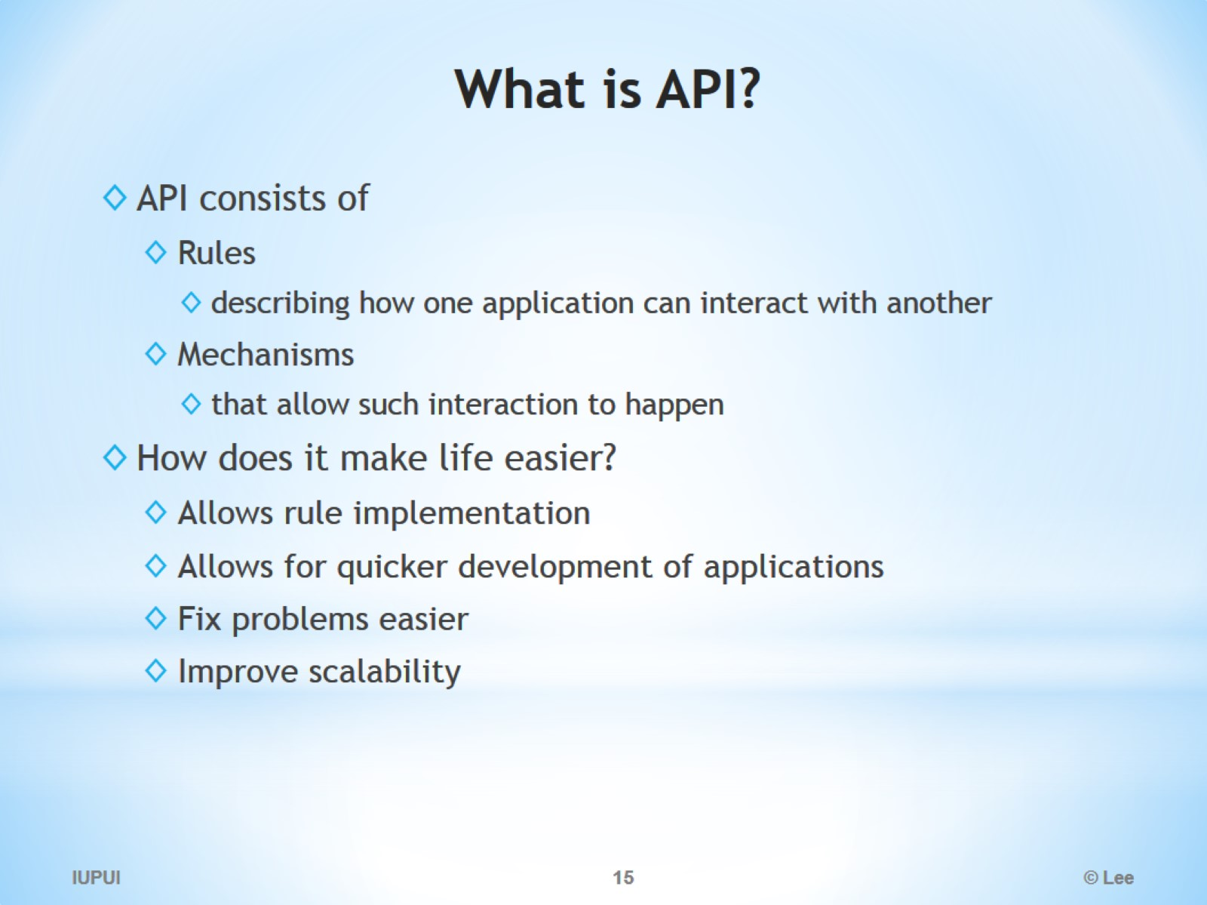
What is API?

Slide 16
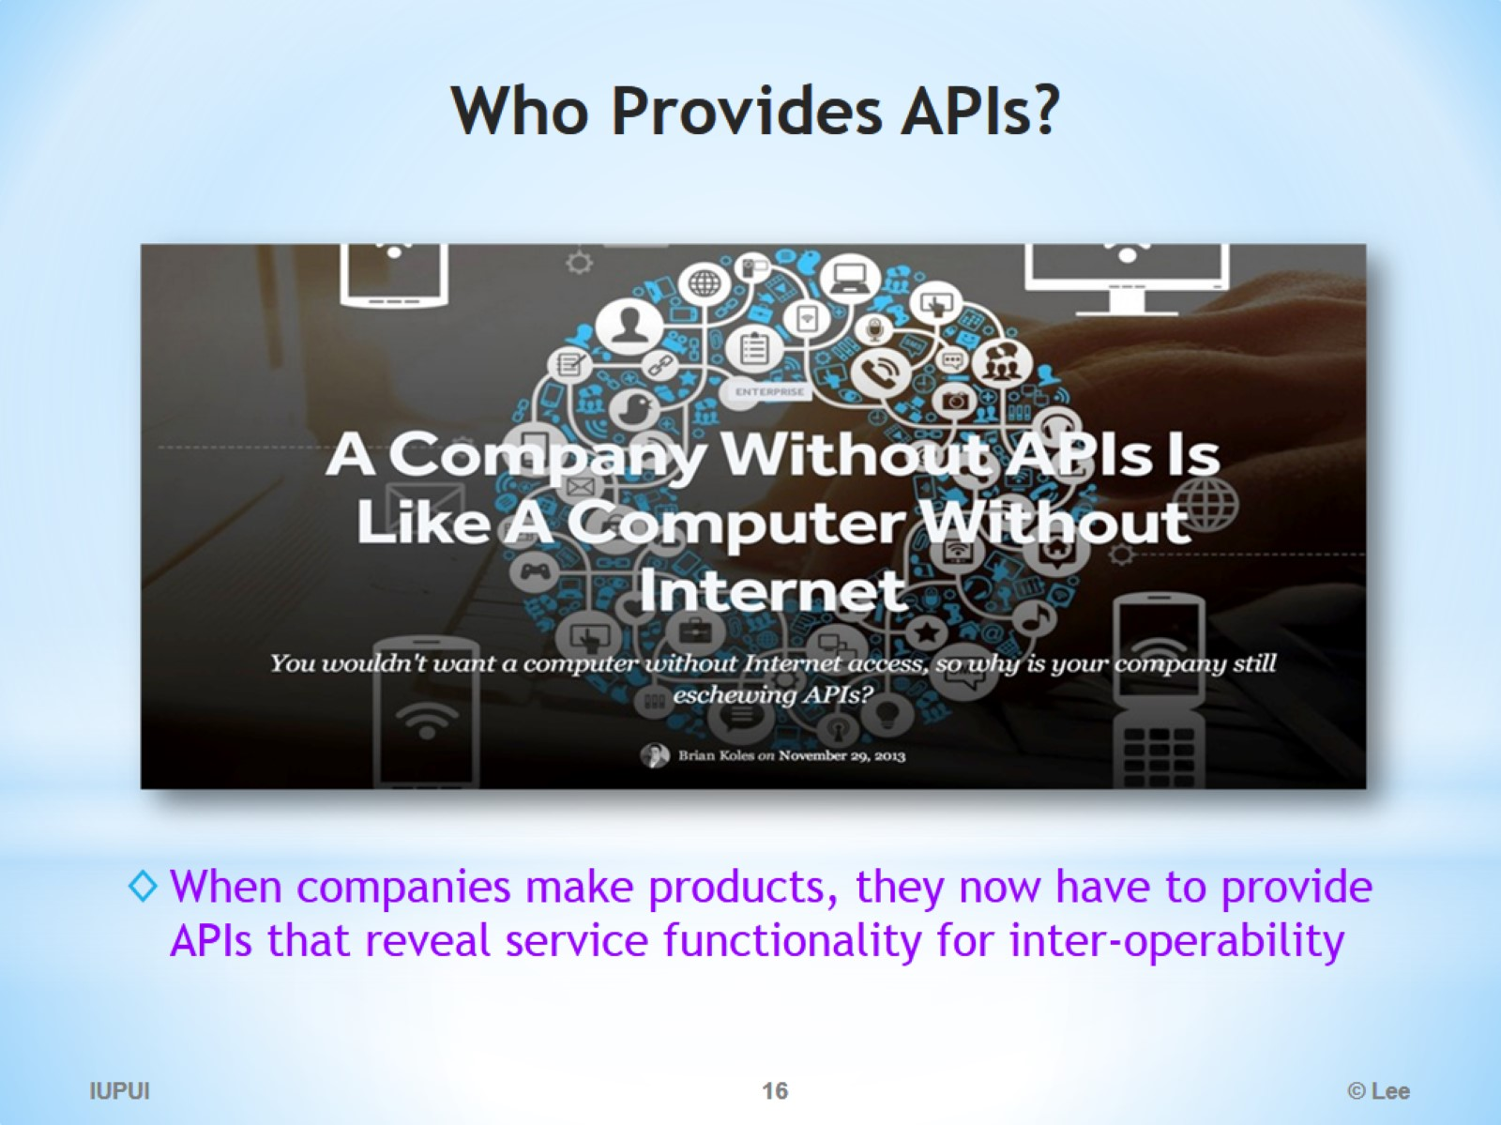
Who Provides APIs?

Slide 17
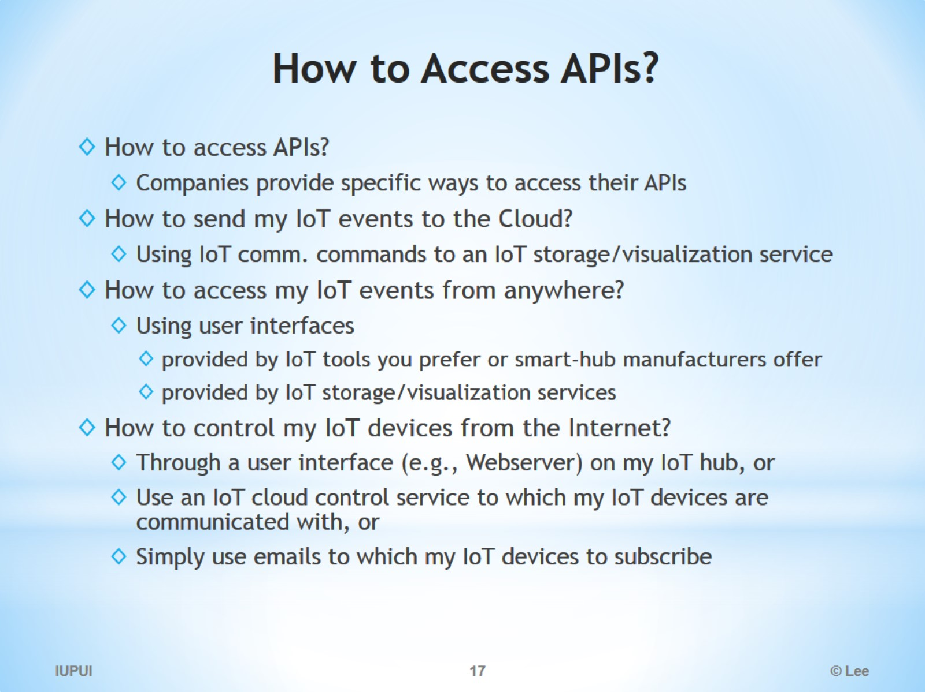
How to Access APIs?

Slide 18
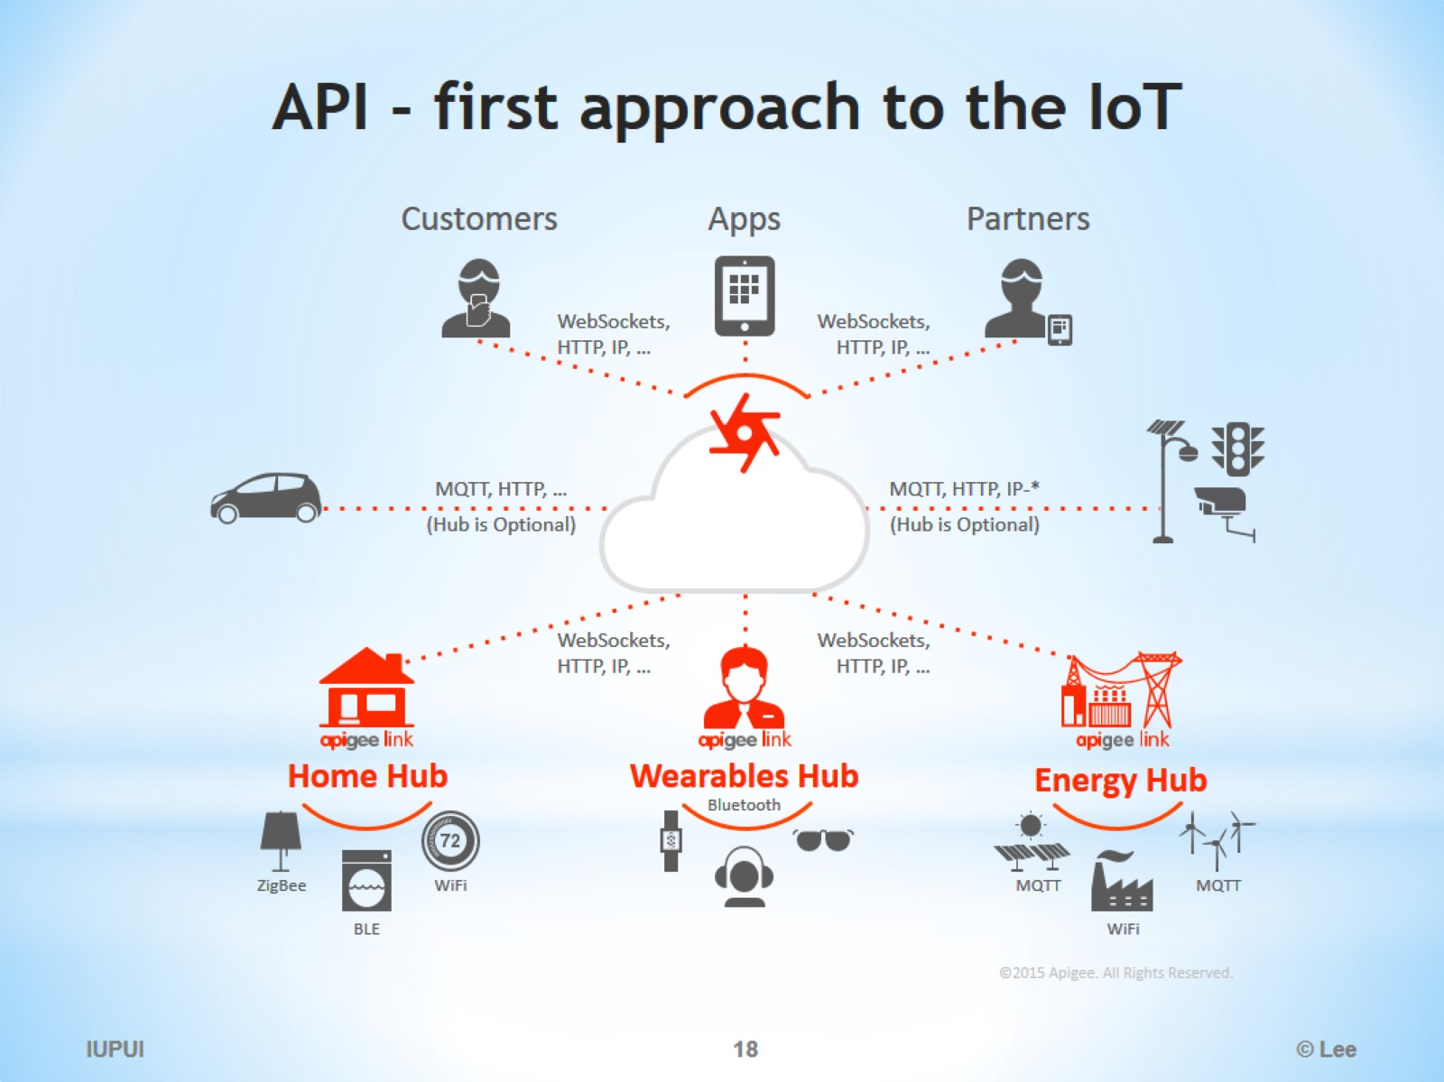
API - first approach to the IoT

Slide 19
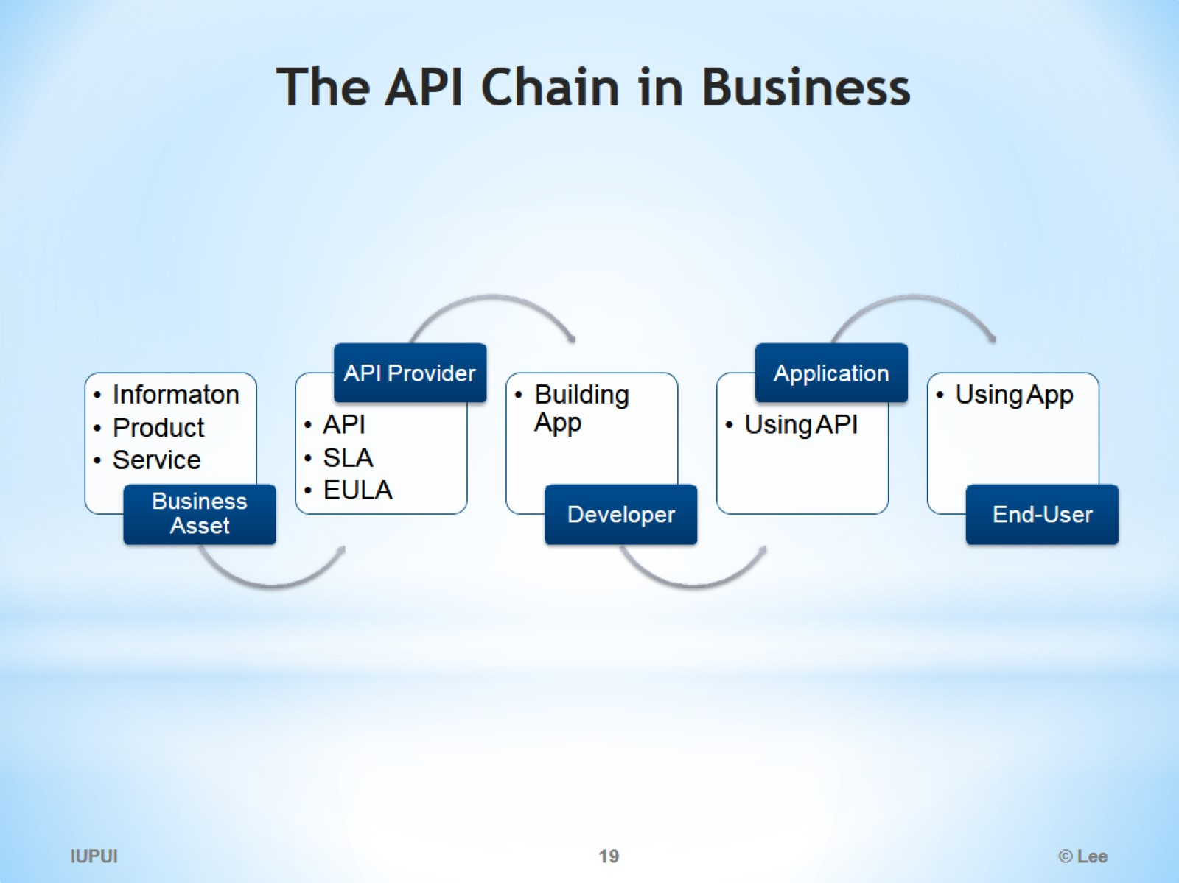
The API Chain in Business

Slide 20
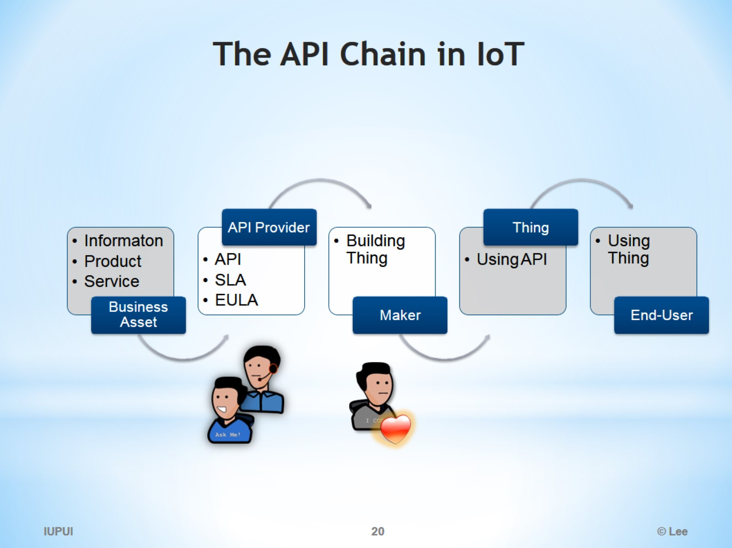
The API Chain in IoT

Slide 21
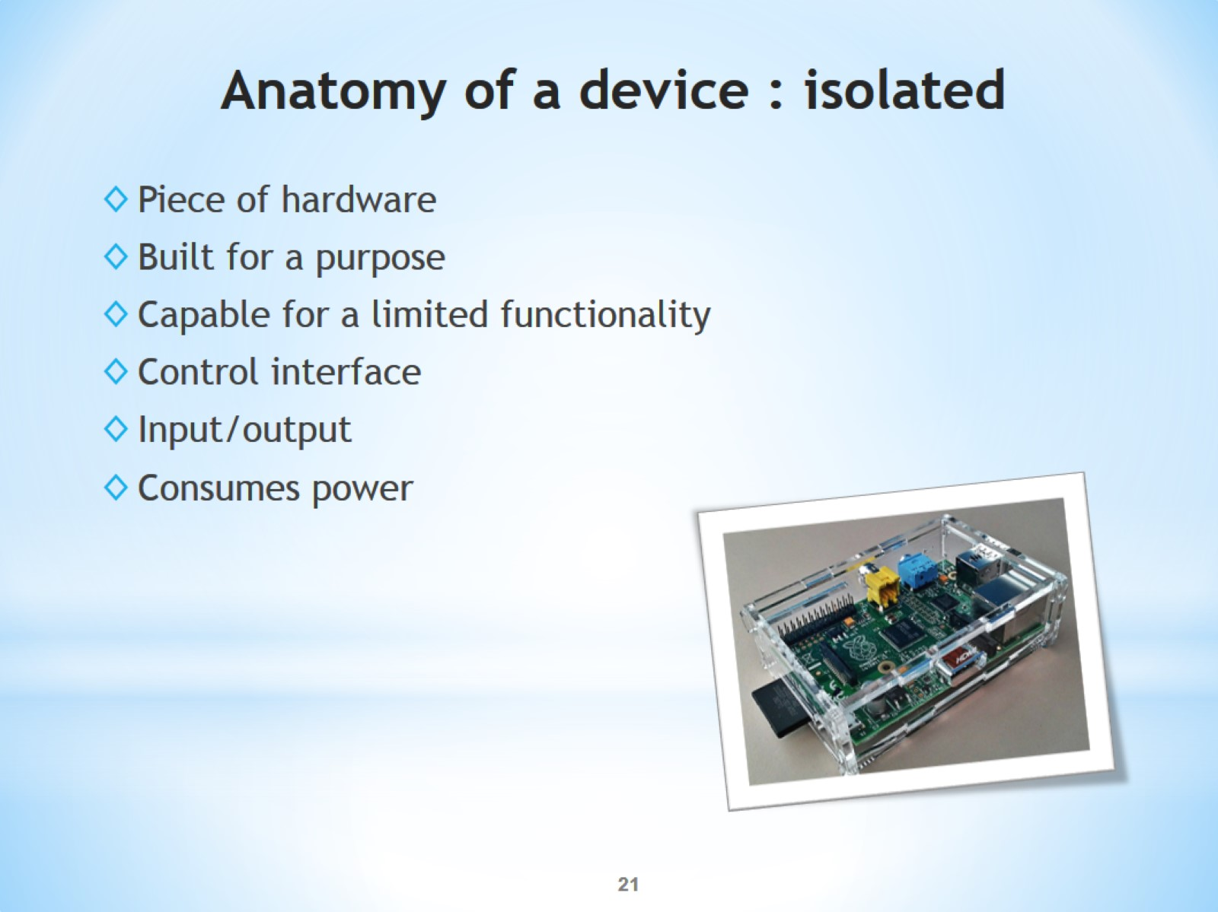
Anatomy of a device : isolated

Slide 22
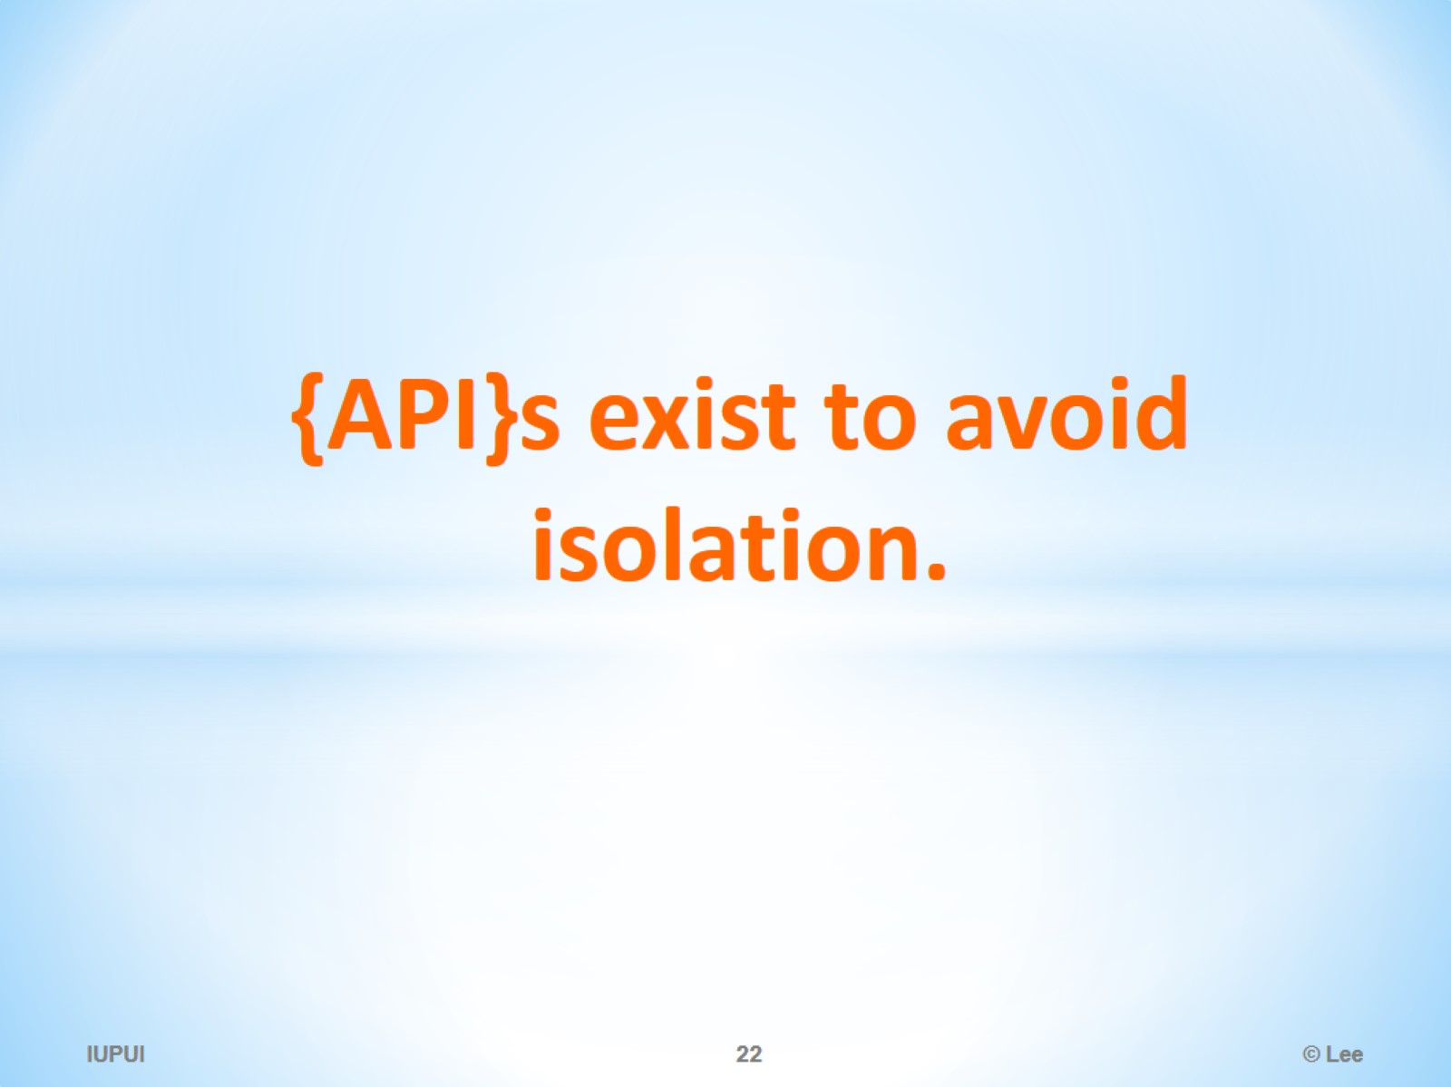
{API}s exist to avoid isolation.

Slide 23
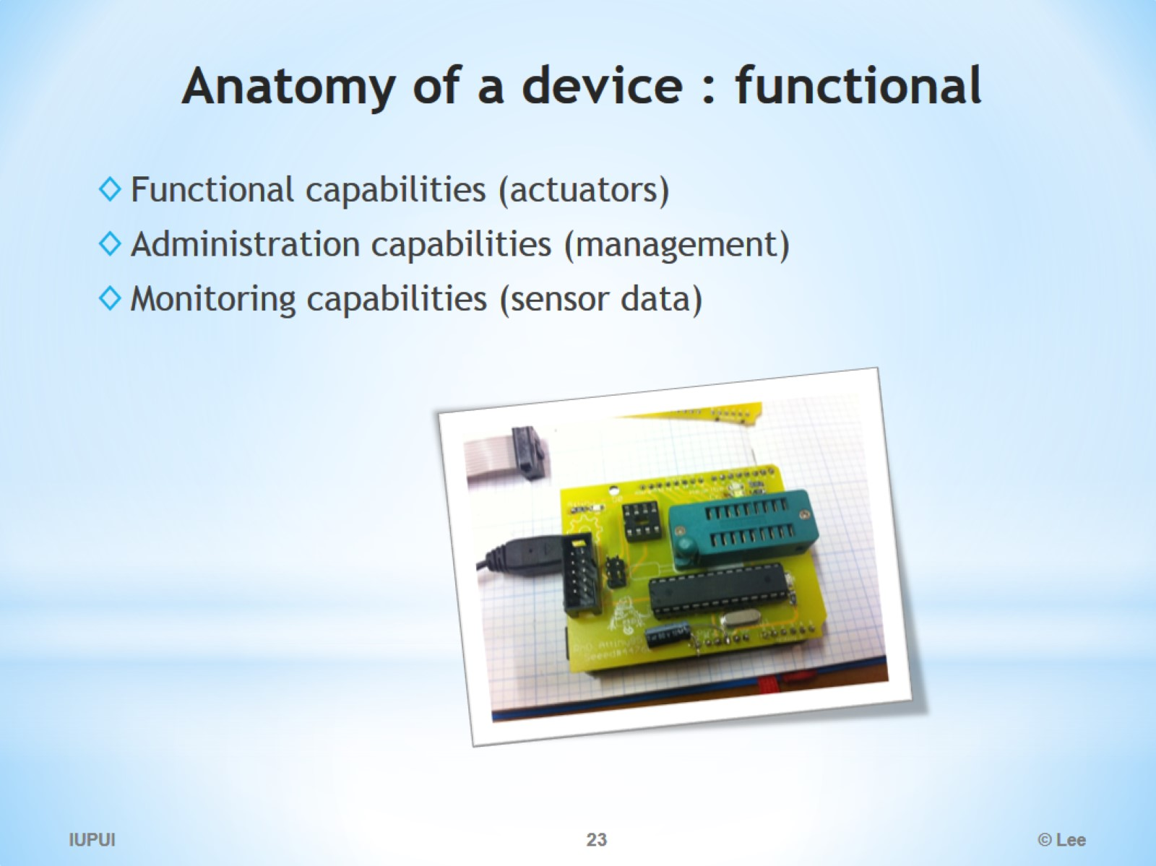
Anatomy of a device : functional

Slide 24
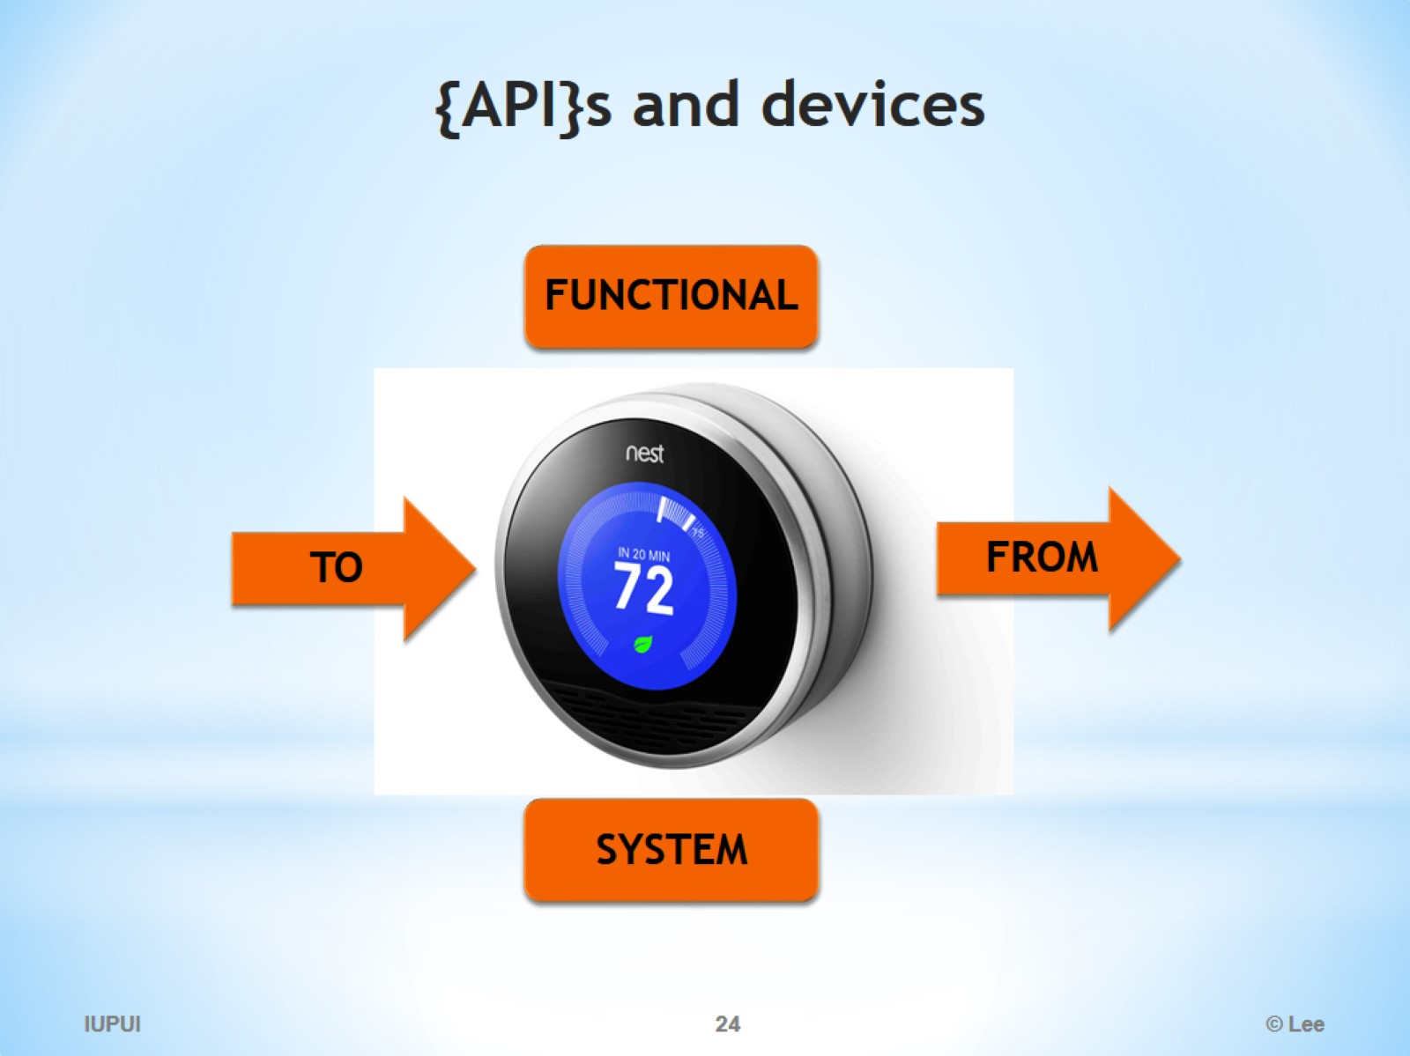
{API}s and devices

Slide 25
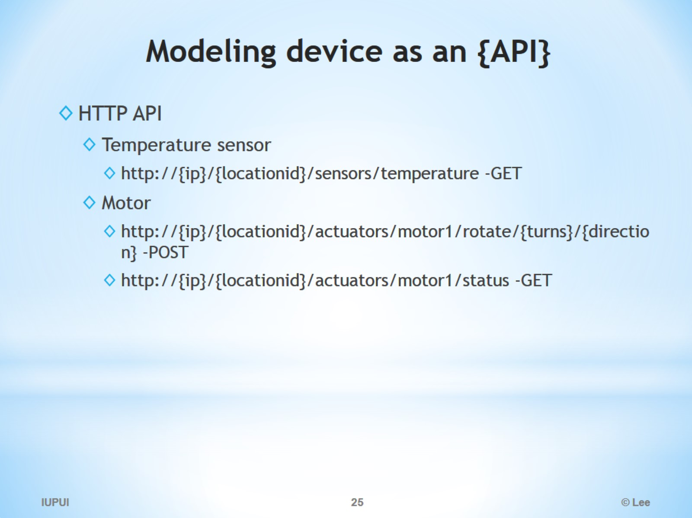
Modeling device as an {API}

Slide 26
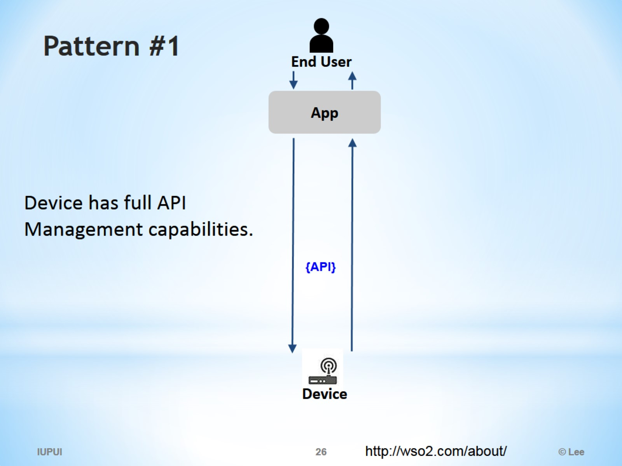
Pattern #1

Slide 27
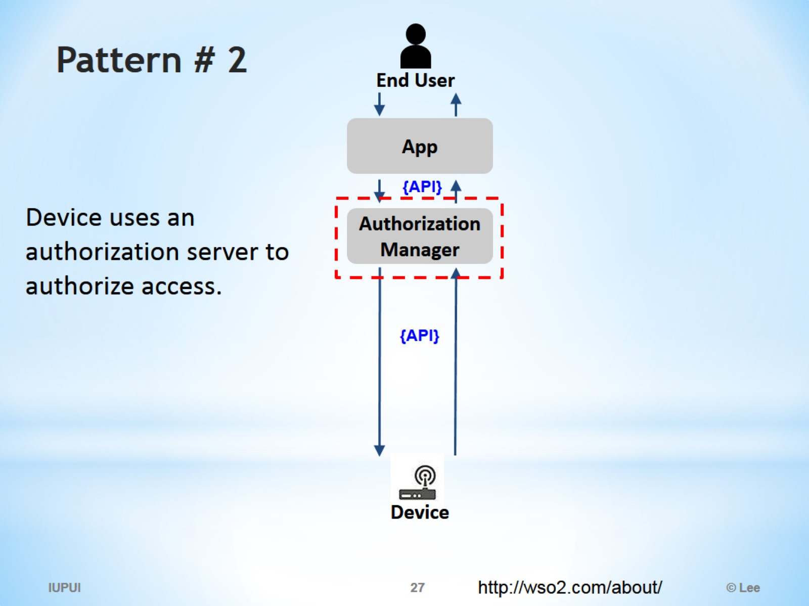
Pattern # 2

Slide 28
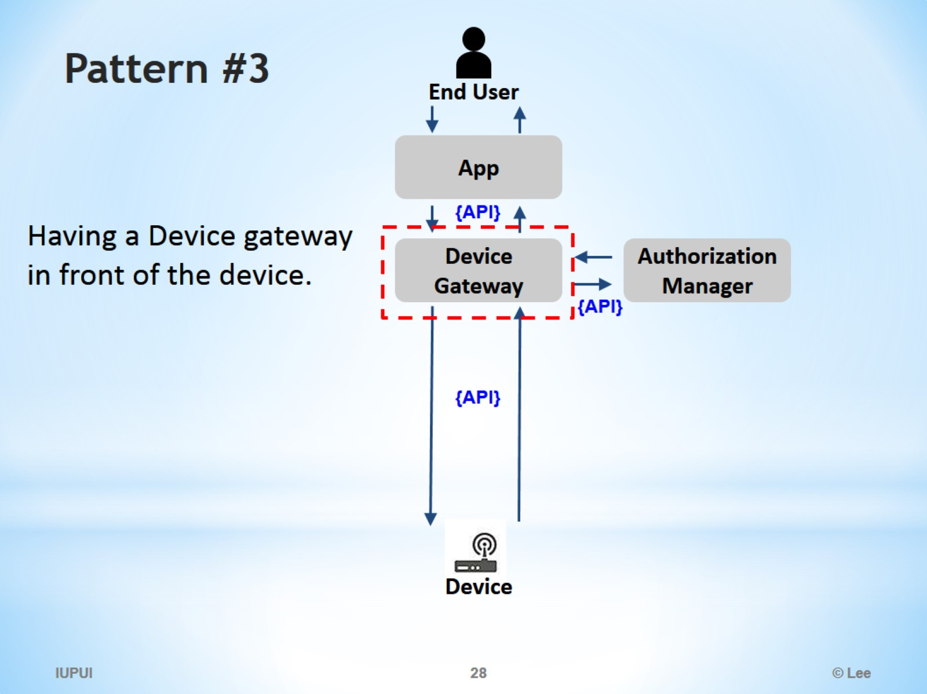
Pattern #3

Slide 29
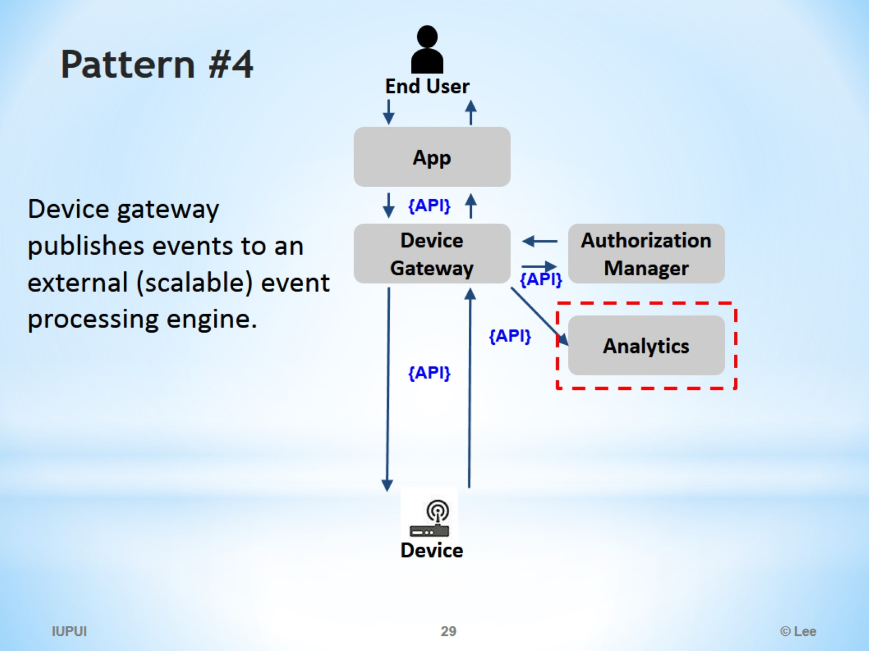
Pattern #4

Slide 30
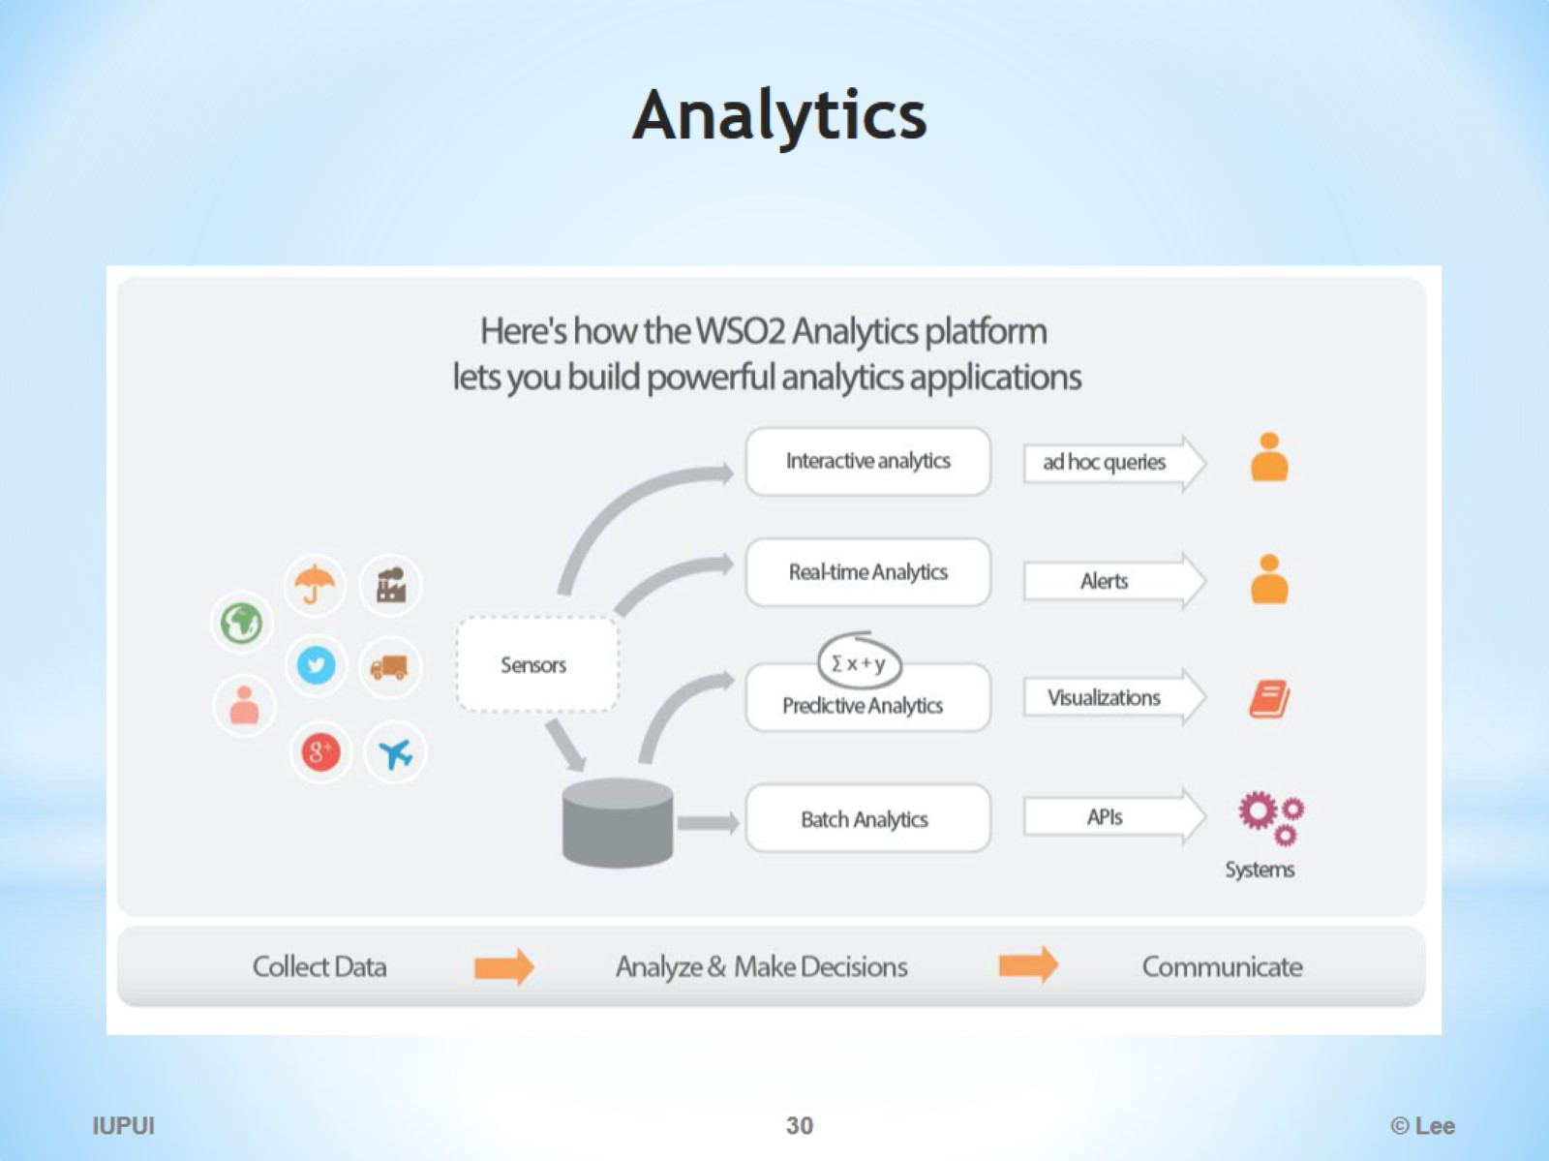
Analytics

Slide 31
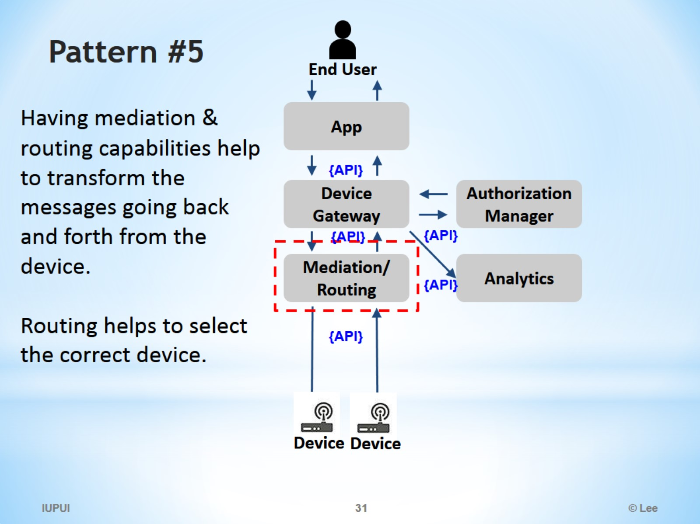
Pattern #5

Slide 32
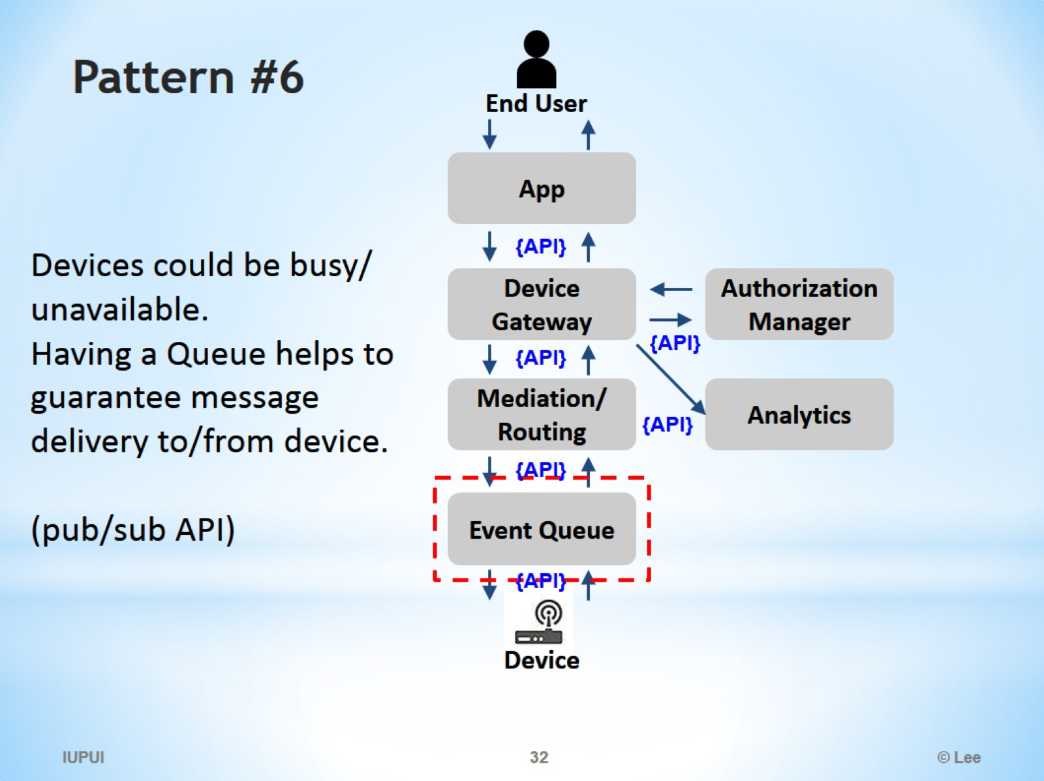
Pattern #6

Slide 33
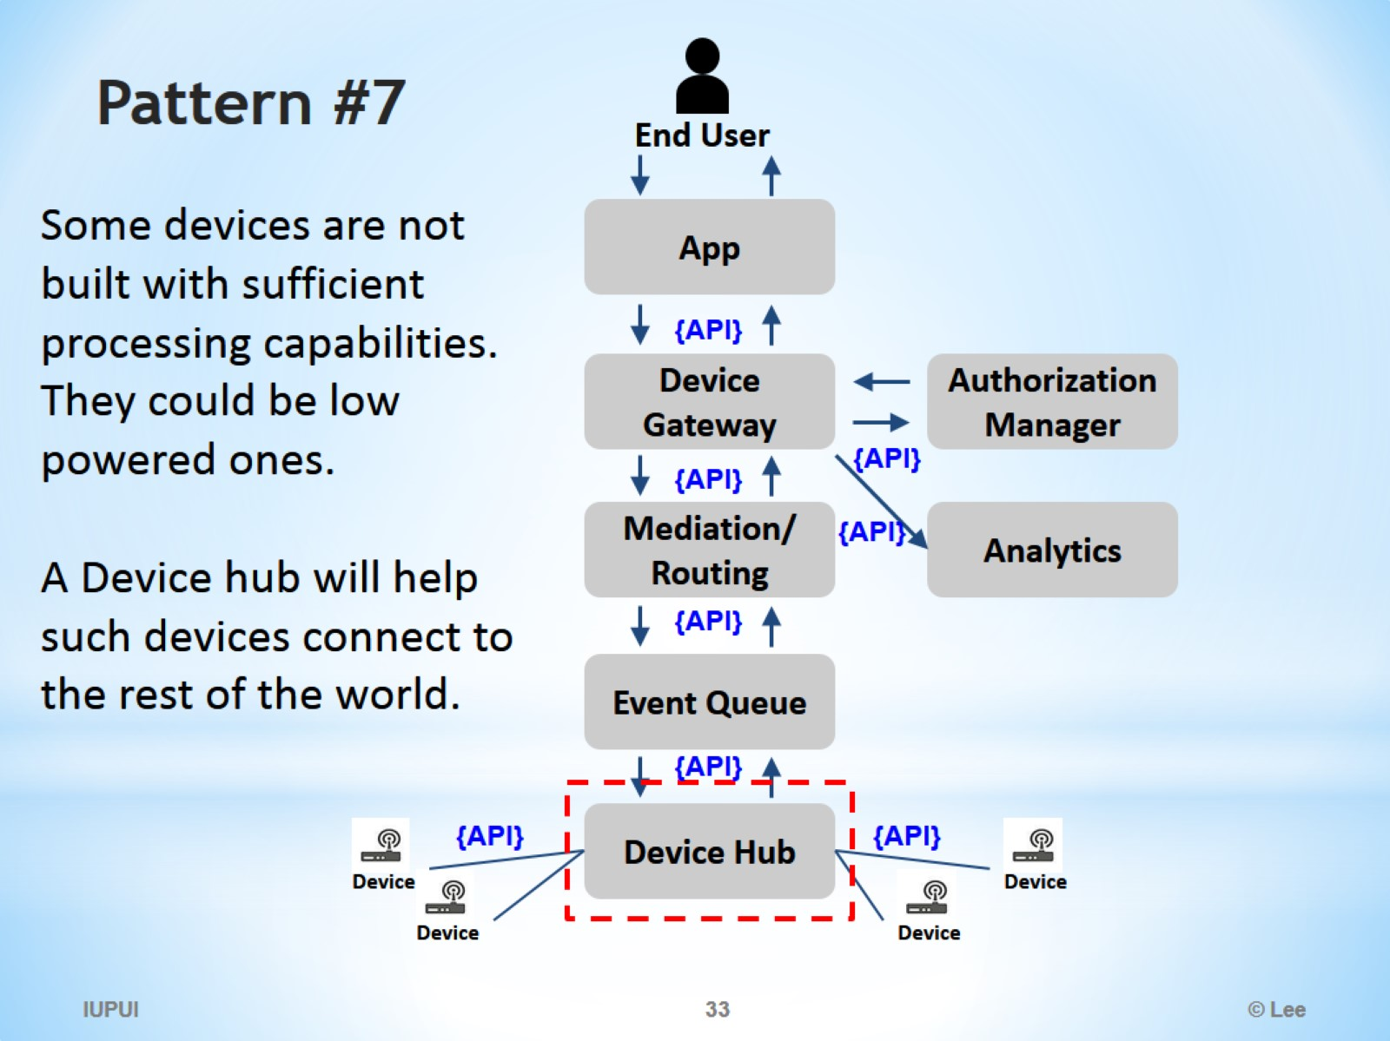
Pattern #7

Slide 34
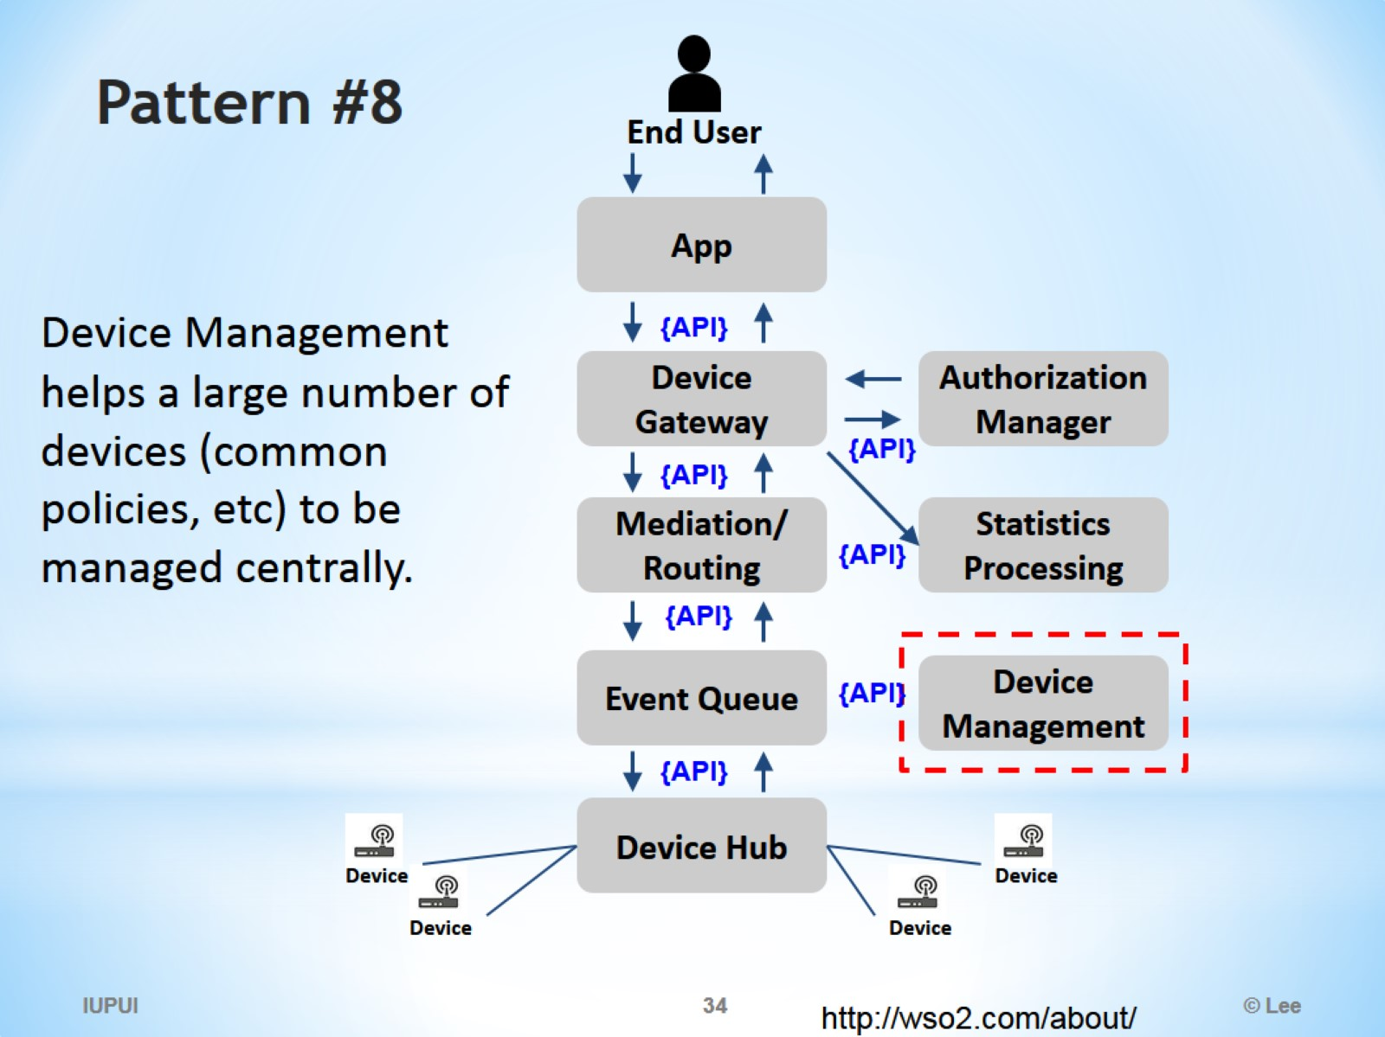
Pattern #8

Slide 35
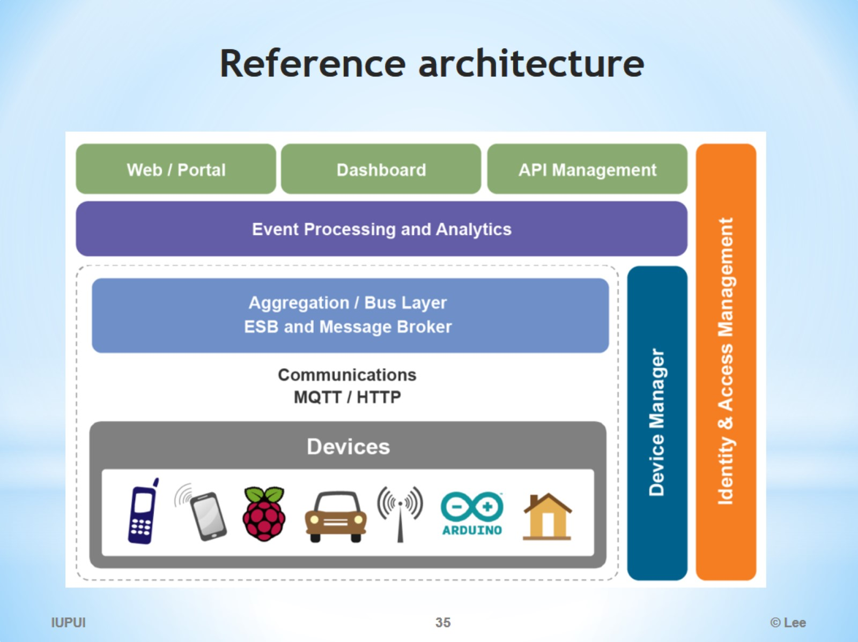
Reference architecture

Slide 36
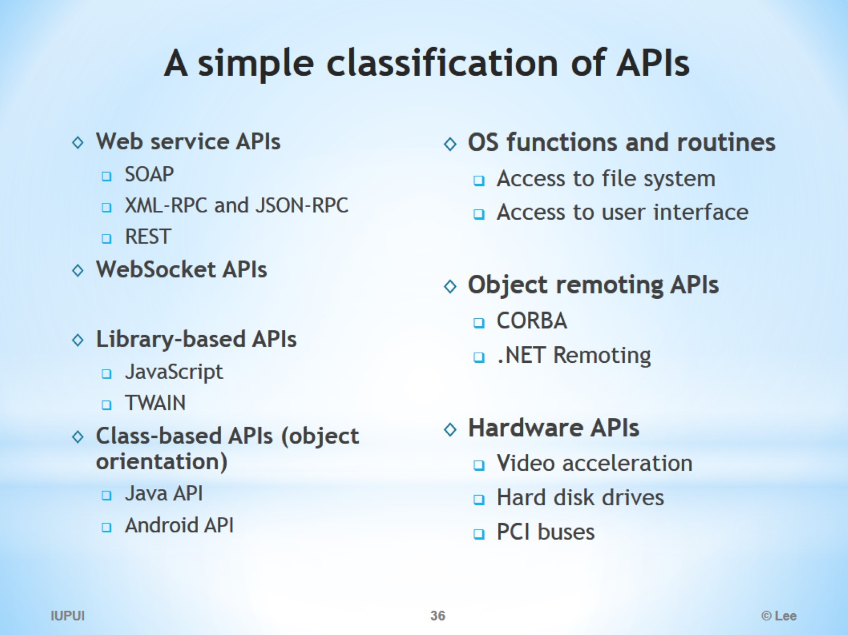
A simple classification of APIs

Slide 37
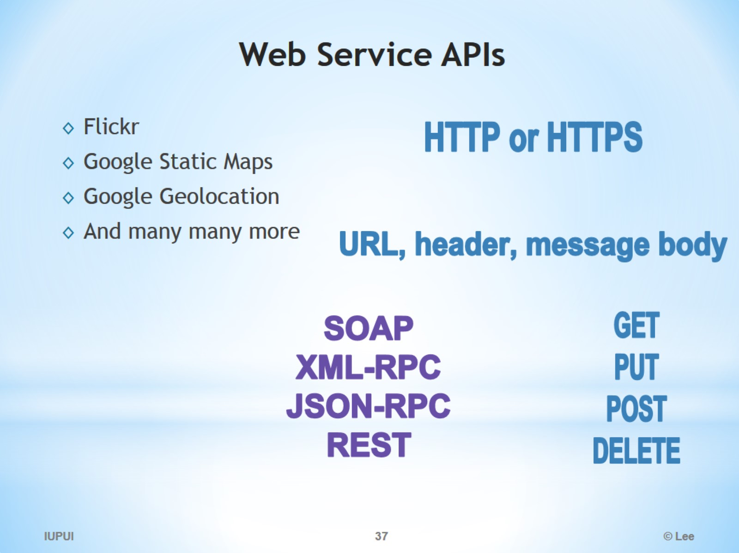
Web Service APIs

Slide 38
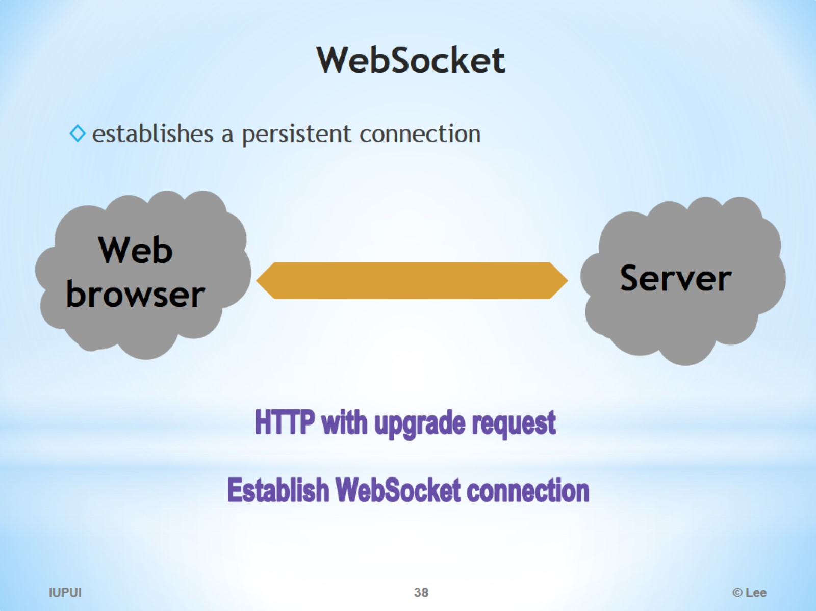
WebSocket

Slide 39
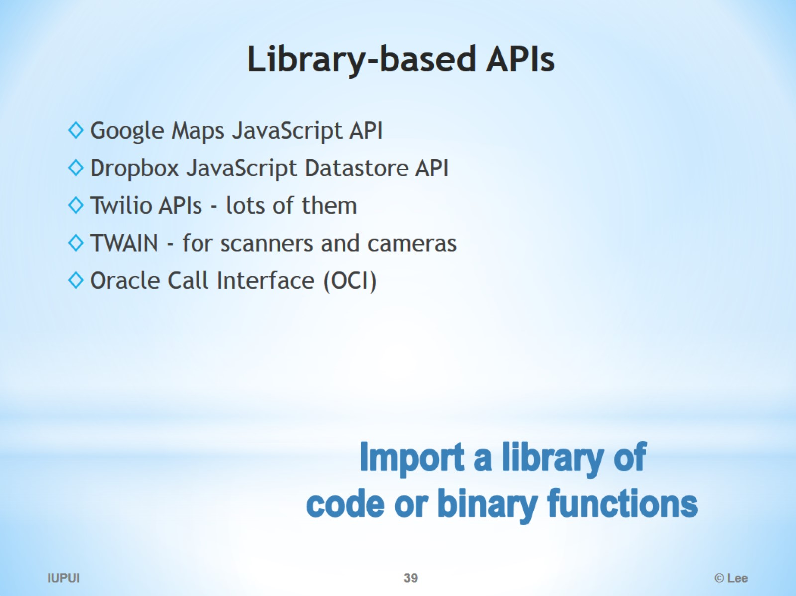
Library-based APIs

Slide 40
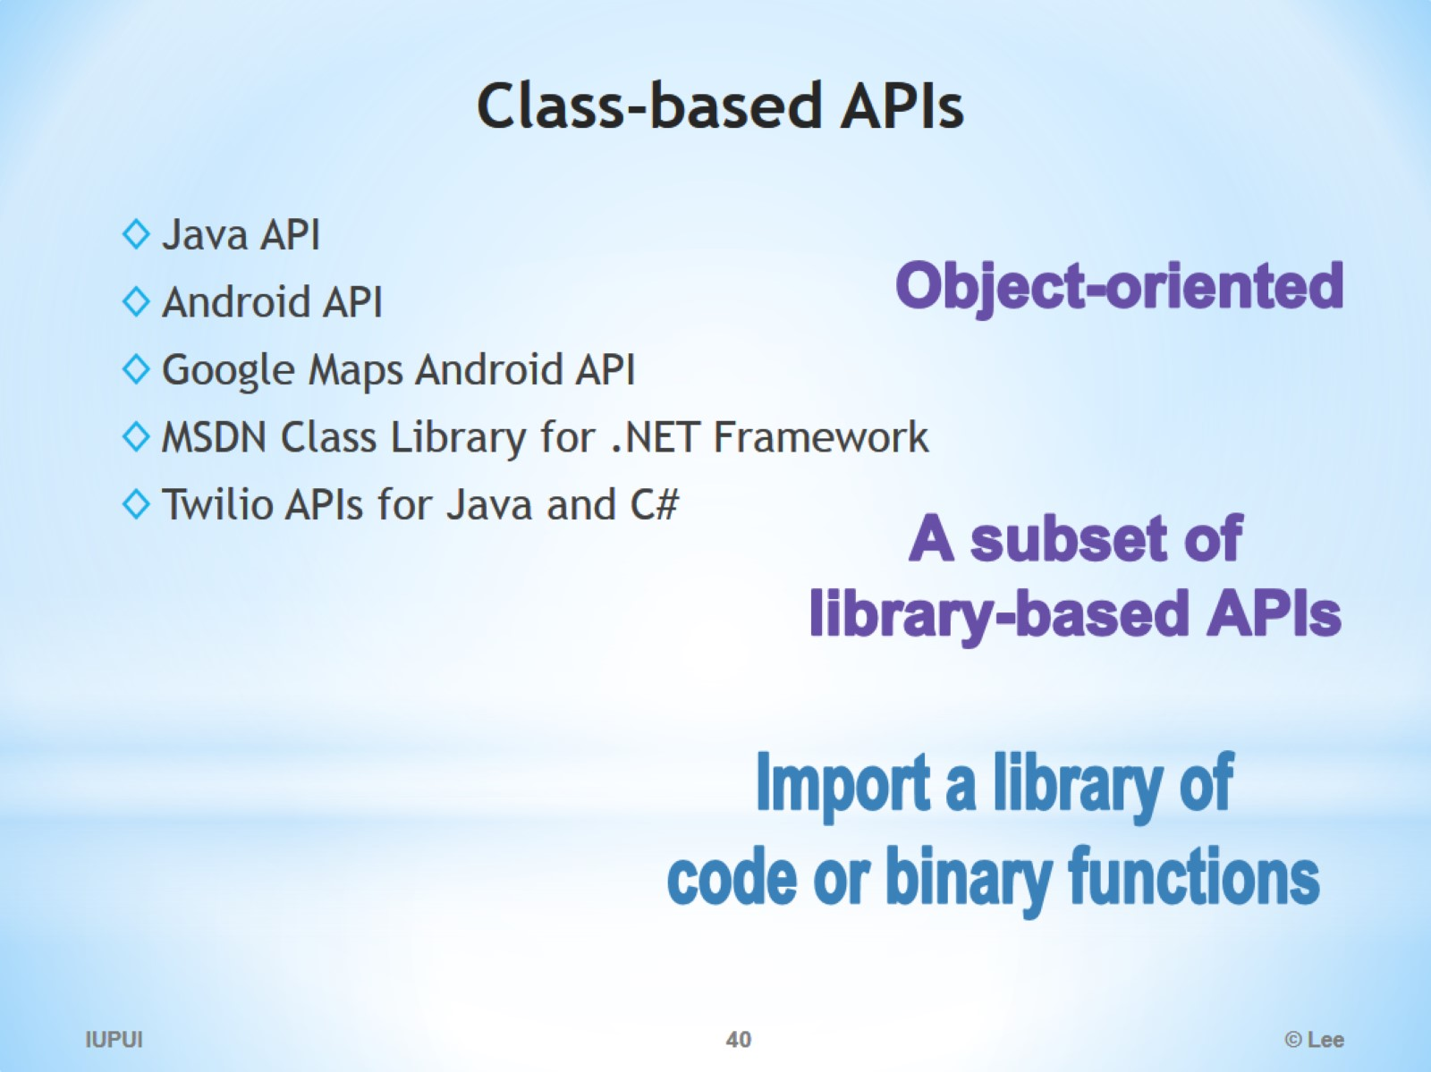
Class-based APIs

Slide 41
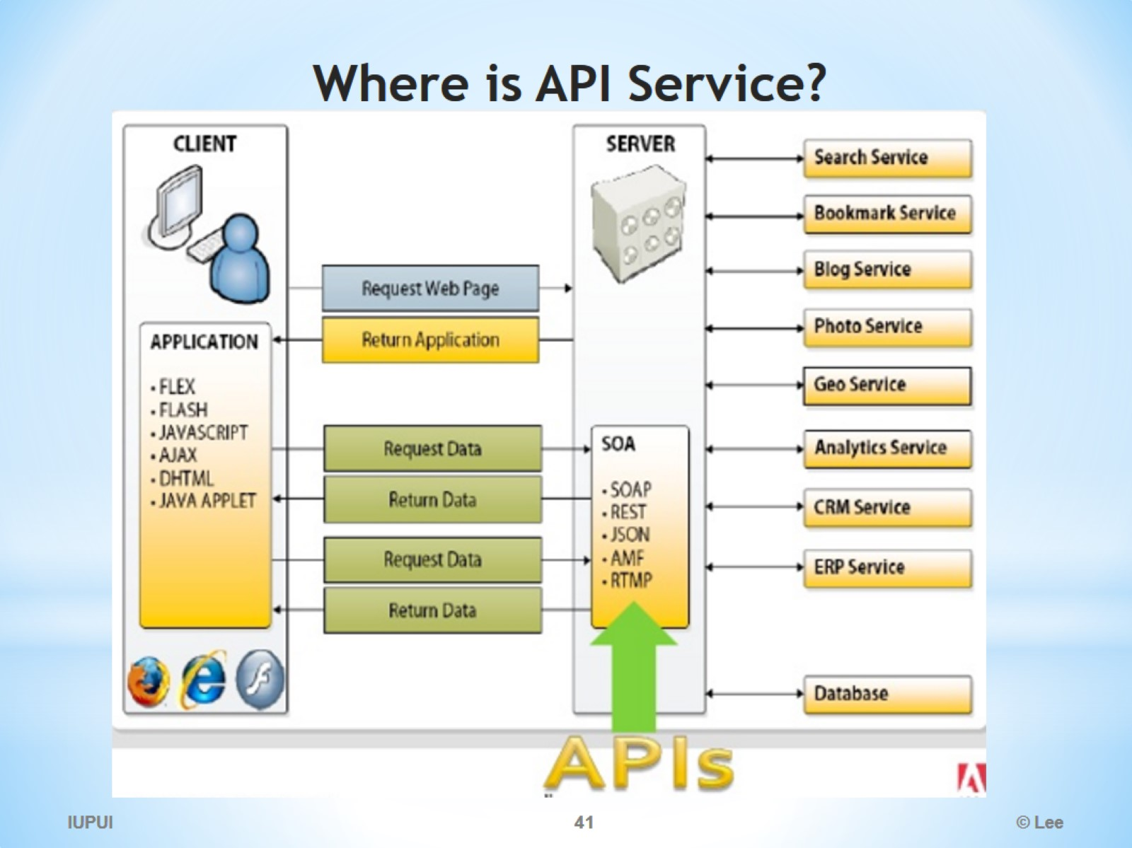
Where is API Service?

Slide 42
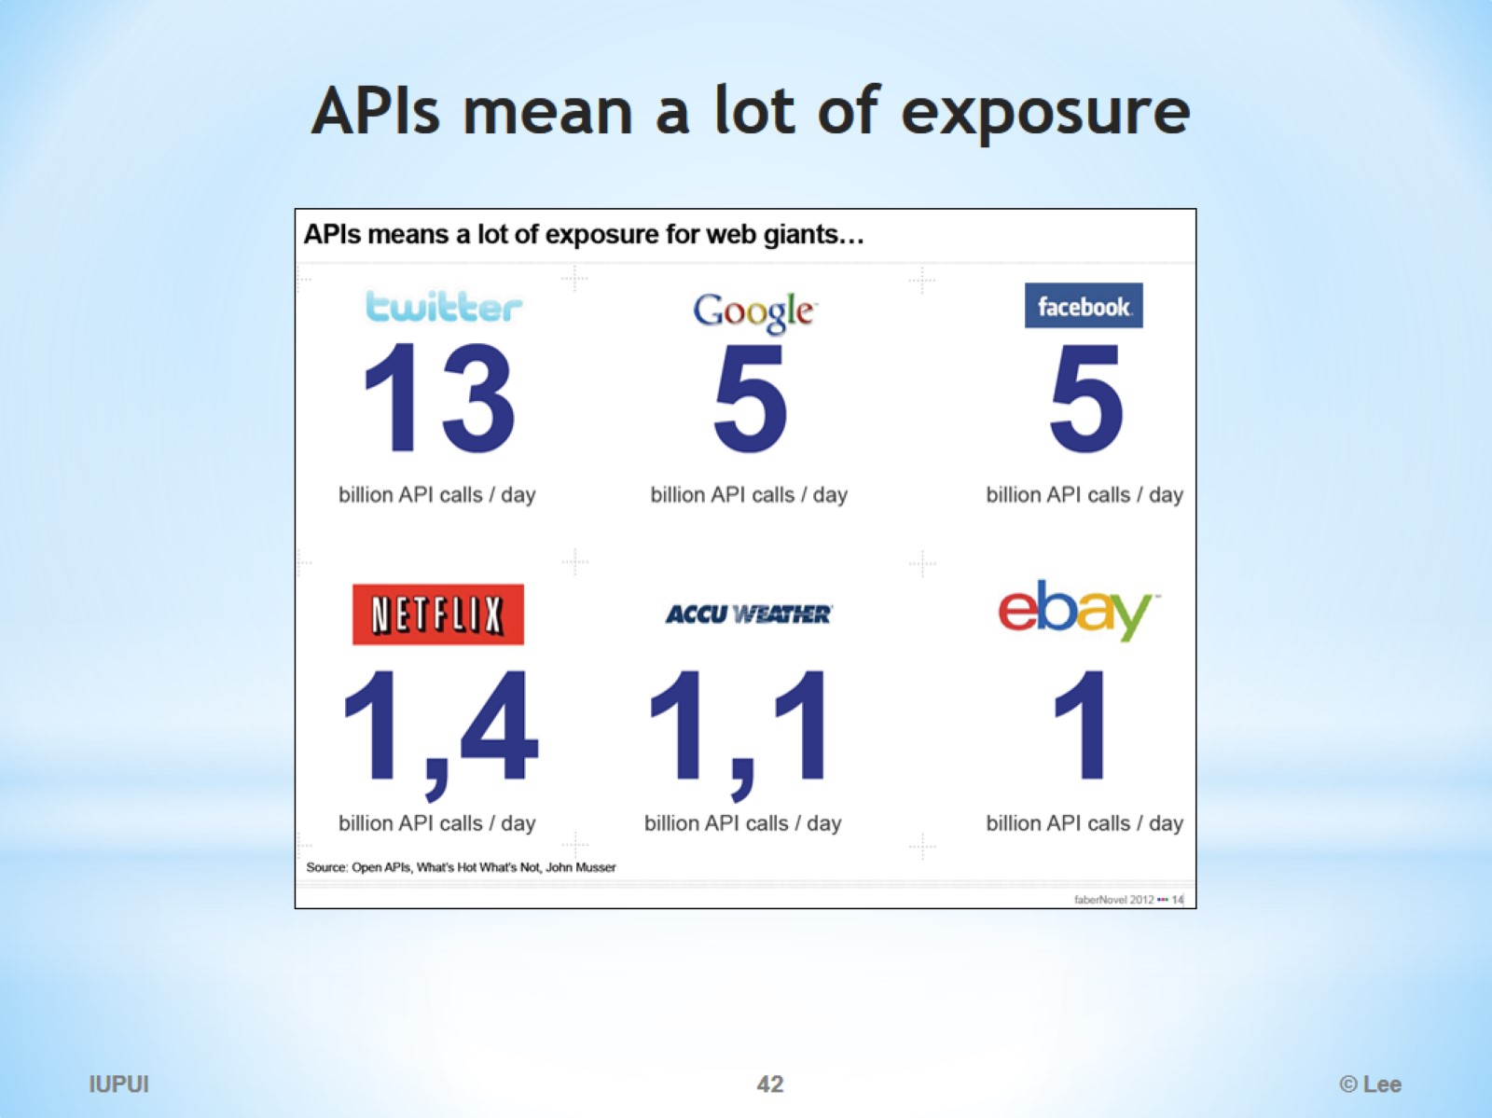
APIs mean a lot of exposure

Slide 43
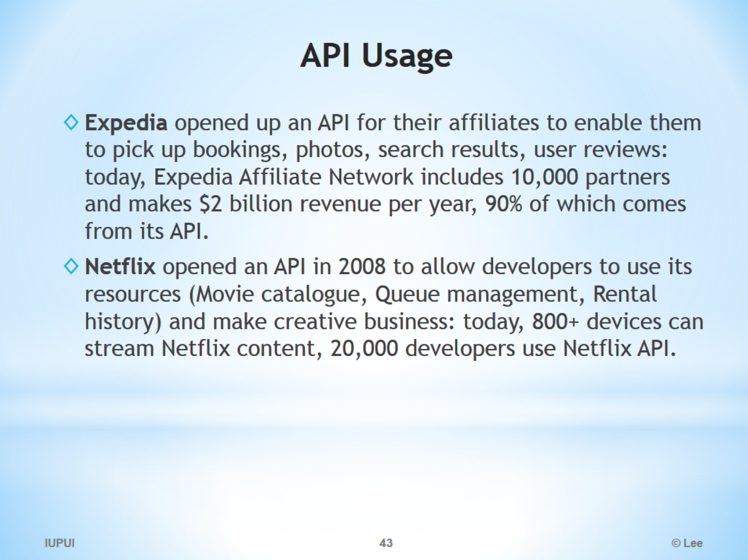
API Usage

Slide 44
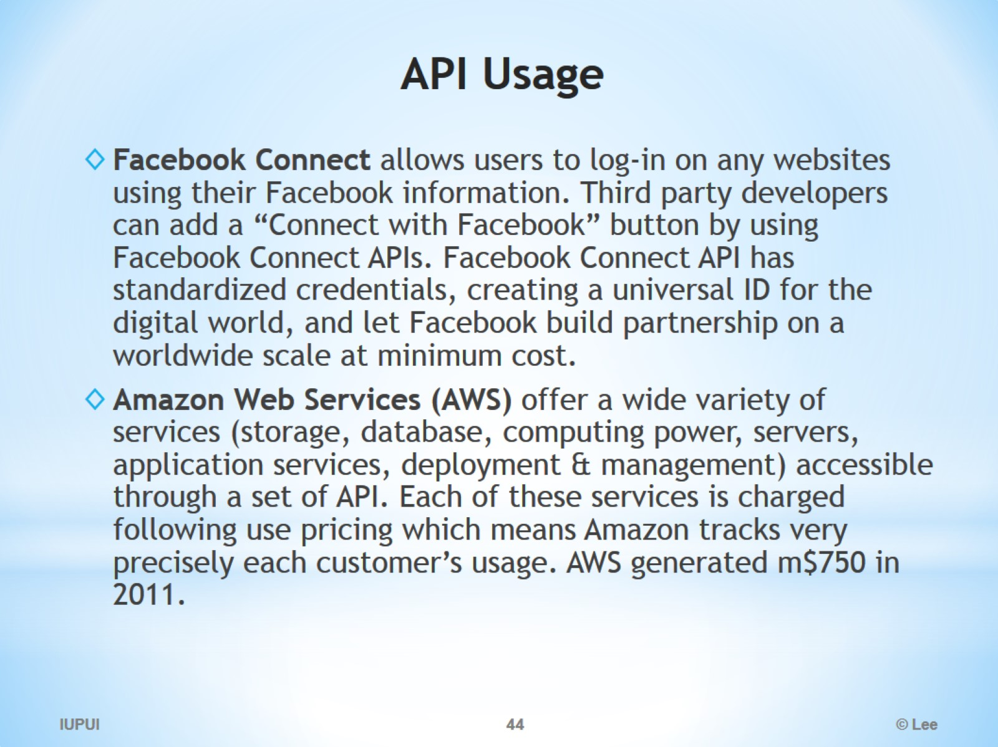
API Usage

Slide 45
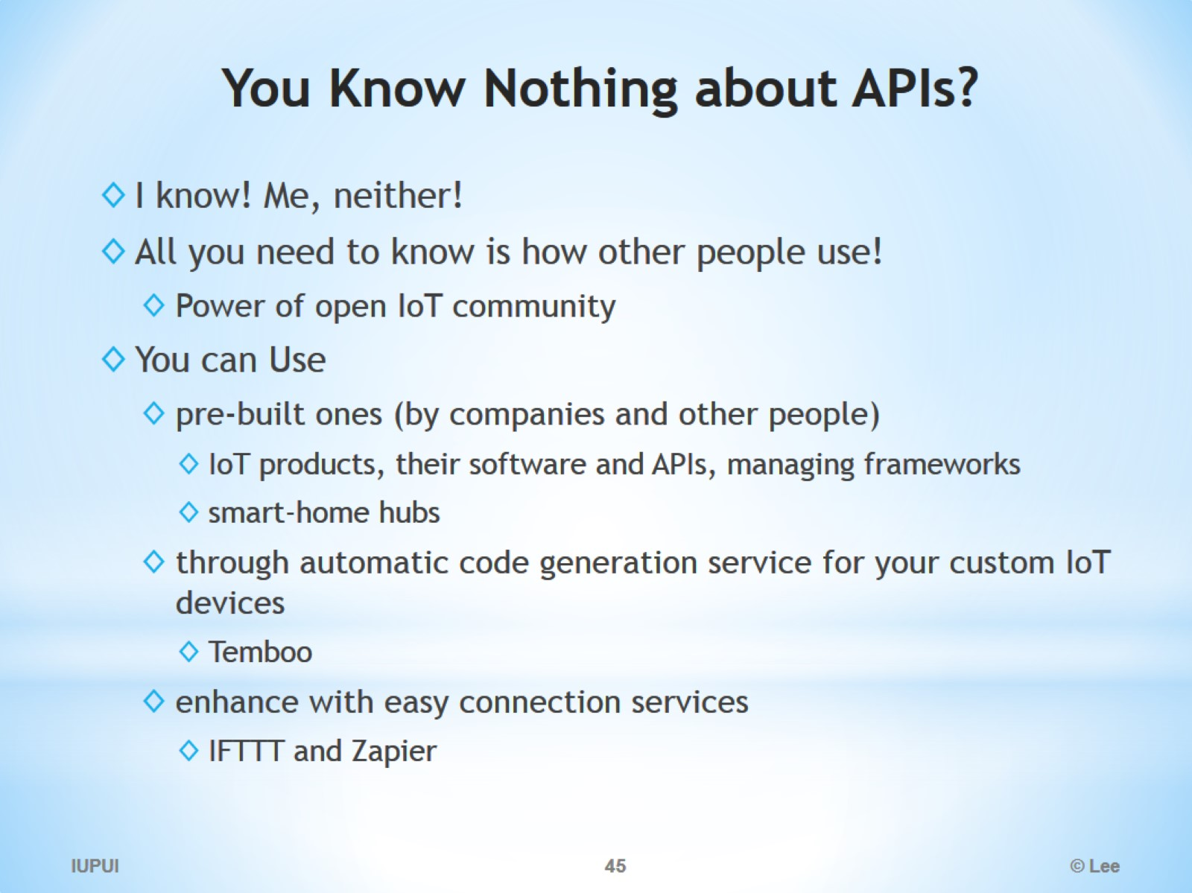
You Know Nothing about APIs?

